Slide 1

Large-Scale Digital Preservation Under Adversarial Conditions
Stephen Reid McLaughlin
March 17, 2018
Athens, Greece

Slide 2
What you’ll need
A BitTorrent client
Transmission: https://transmissionbt.com
Deluge: https://deluge-torrent.org
A text editor
Atom: https://atom.io
Sublime Text: https://www.sublimetext.com
Docker
https://docs.docker.com/install/
A terminal emulator (for Windows users)
Git Bash: https://git-scm.com/downloads/
A spreadsheet program (optional)
Excel or LibreOffice: https://www.libreoffice.org
Stephen Reid McLaughlin / @SteveMcLaugh

Slide 3
Liang’s definition of
shadow libraries:
“spaces as well as practices ... which exist in the shadows cast by the long history of monumental libraries” (2012)
Adopted as a generic term for likely infringing text collections
(Tenen and Foxman 2014; Bodó 2015, 2016)
Lawrence Liang in 2011. recht-als-kultur.de.
Stephen Reid McLaughlin / @SteveMcLaugh
Notes:
De Kosnik’s term: Rogue Archives
I’m friends with a lot of LIS people, who object to both these terms – they’d call it a collection.
Coined in a 2012 essay by the Indian writer and activist Lawrence Liang
don’t think he meant to name a movement or a field of study
discussing the shuttering of Library.nu in a longer history of library destruction
Photo credit: http://www.recht-als-kultur.de/en/activities/forum-law-as-culture.3/lawrence-liang-optics-of-justice-where-legal-theory-and-film-theory-intersect.20/

Slide 4
LibGen's operators “learned that it is possible to set up highly efficient clandestine knowledge distribution networks to circumvent access obstacles, evade enforcement, and build influential underground knowledge repositories under hostile circumstances.”
(Bodó 2015)
Balázs Bodó. warsystems.hu.
Stephen Reid McLaughlin / @SteveMcLaugh
Notes:
Photo credit: http://www.warsystems.hu/2010/05/03/bio/

Slide 5
My Research Methods
15 formal interviews with scholars, participants, site operators
Sci-Hub usage logs
LibGen metadata dumps
Collecting commentary in news media, blogs, Twitter, Reddit, etc.
Introducing myself to strangers
Stephen Reid McLaughlin / @SteveMcLaugh

Slide 6
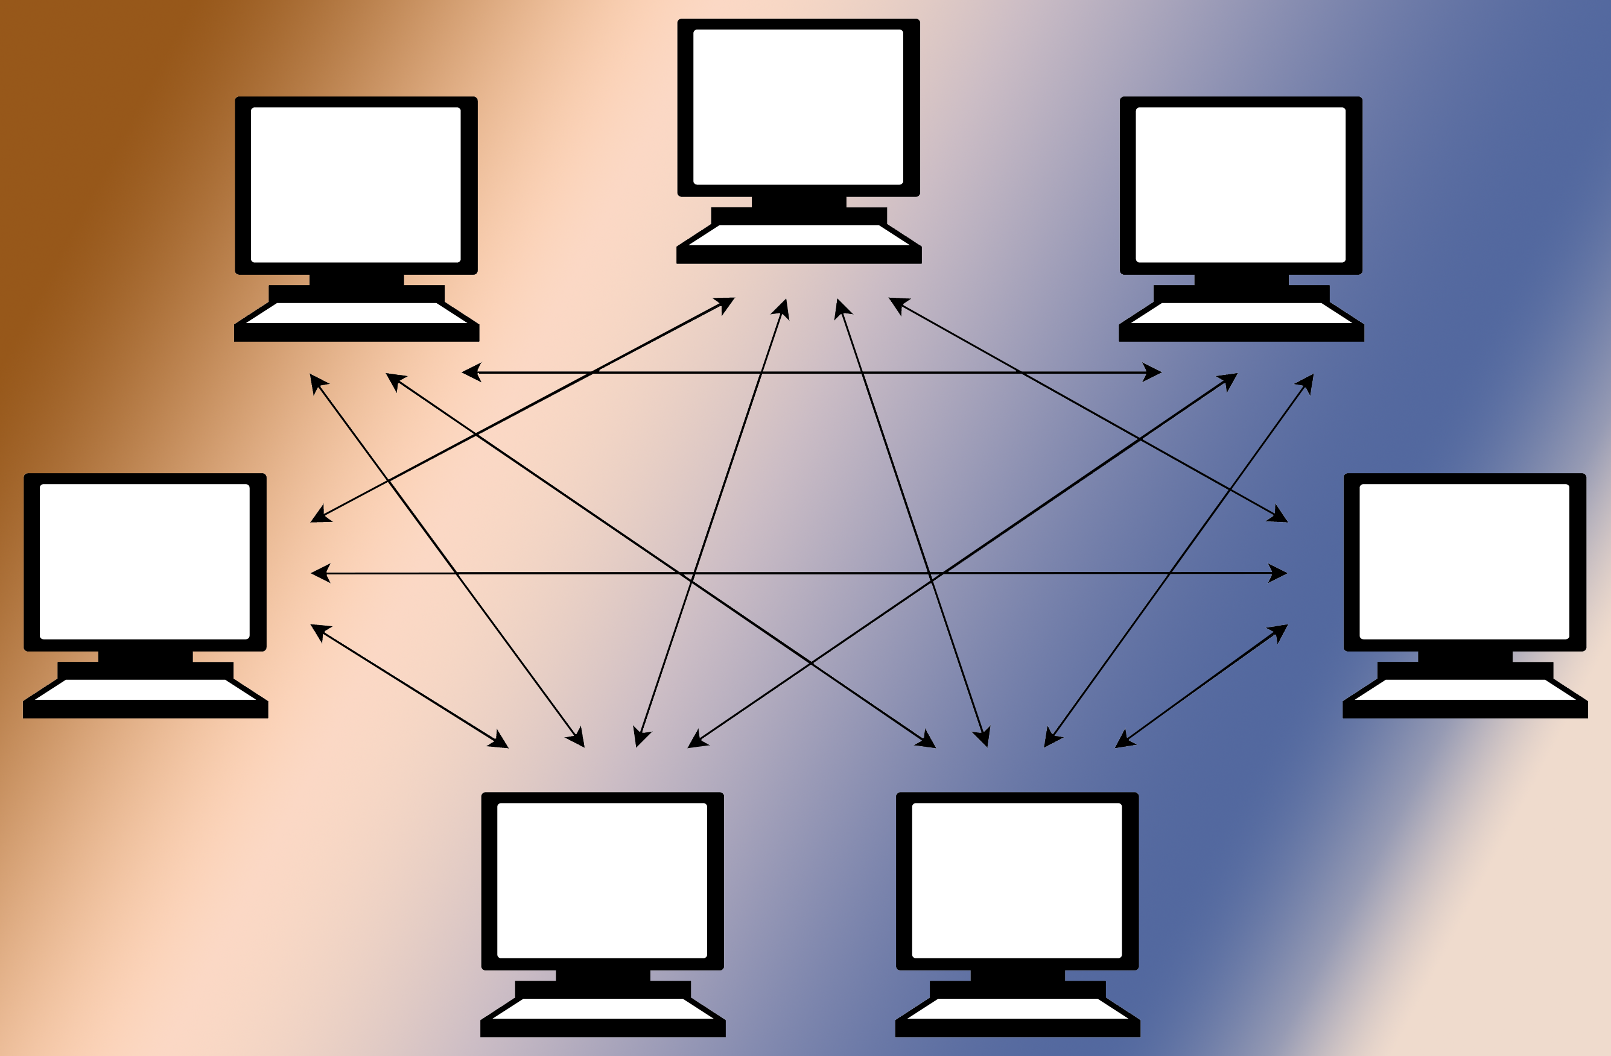
Stephen Reid McLaughlin / @SteveMcLaugh
Notes:
The goal: an archive that will live on. A distributed archive.
My archivist friends …

Slide 7
Blockchain = unique ownership
Stephen Reid McLaughlin / @SteveMcLaugh
Notes:
Prior to blockchain, wee already did distributed computing in an open form.
Because I’ve been poor at times, and I’ll never be able to afford the library I dream of

Slide 8
Blockchain = unique ownership BitTorrent = distributed buffet
Stephen Reid McLaughlin / @SteveMcLaugh
Notes:
Prior to blockchain, wee already did distributed computing in an open form.
Because I’ve been poor at times, and I’ll never be able to afford the library I dream of

Slide 9
Blockchains are designed to avoid the double spending problem.
Stephen Reid McLaughlin / @SteveMcLaugh

Slide 10
Blockchains are designed to avoid the double spending problem. But I like double spending!
Stephen Reid McLaughlin / @SteveMcLaugh

Slide 11
Blockchains are designed to avoid the double spending problem. But I like double spending! They’re designed to be indelible.
Stephen Reid McLaughlin / @SteveMcLaugh

Slide 12
Blockchains are designed to avoid the double spending problem. But I like double spending! They’re designed to be indelible. But I like obfuscation!
Stephen Reid McLaughlin / @SteveMcLaugh

Slide 13
Blockchains are designed to avoid the double spending problem. But I like double spending! They’re designed to be indelible. But I like obfuscation! They’re designed to keep everyone on the same page.
Stephen Reid McLaughlin / @SteveMcLaugh

Slide 14
Blockchains are designed to avoid the double spending problem. But I like double spending! They’re designed to be indelible. But I like obfuscation! They’re designed to keep everyone on the same page. But I like variants!
Stephen Reid McLaughlin / @SteveMcLaugh

Slide 15
De gustibus non est disputandum.
Stephen Reid McLaughlin / @SteveMcLaugh
Notes:
Blockchain is all about avoiding double spending. I LOVE double spending.

Slide 16
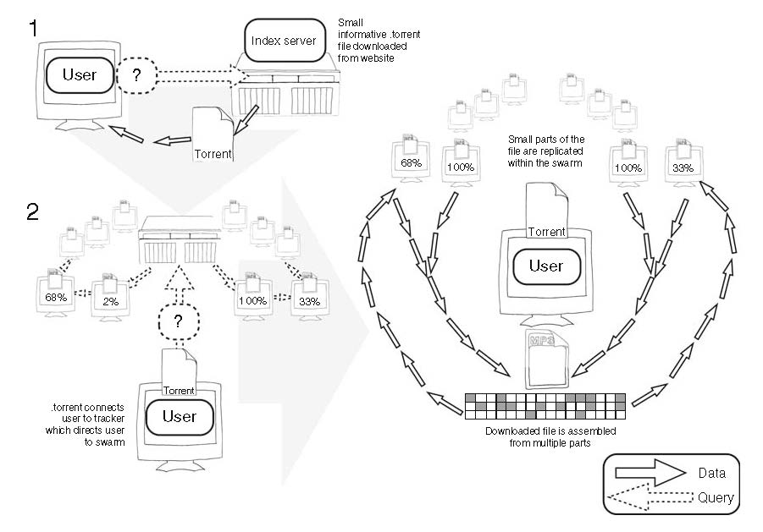
The BitTorrent protocol
Stephen Reid McLaughlin / @SteveMcLaugh

Slide 17
Major BitTorrent clients
Transmission (free software, has a command-line interface)
https://transmissionbt.com
μTorrent (easy and reliable)
https://www.utorrent.com
Deluge (free software, works well with proxies)
https://deluge-torrent.org
Try grabbing a dataset from http://academictorrents.com.
Stephen Reid McLaughlin / @SteveMcLaugh

Slide 18
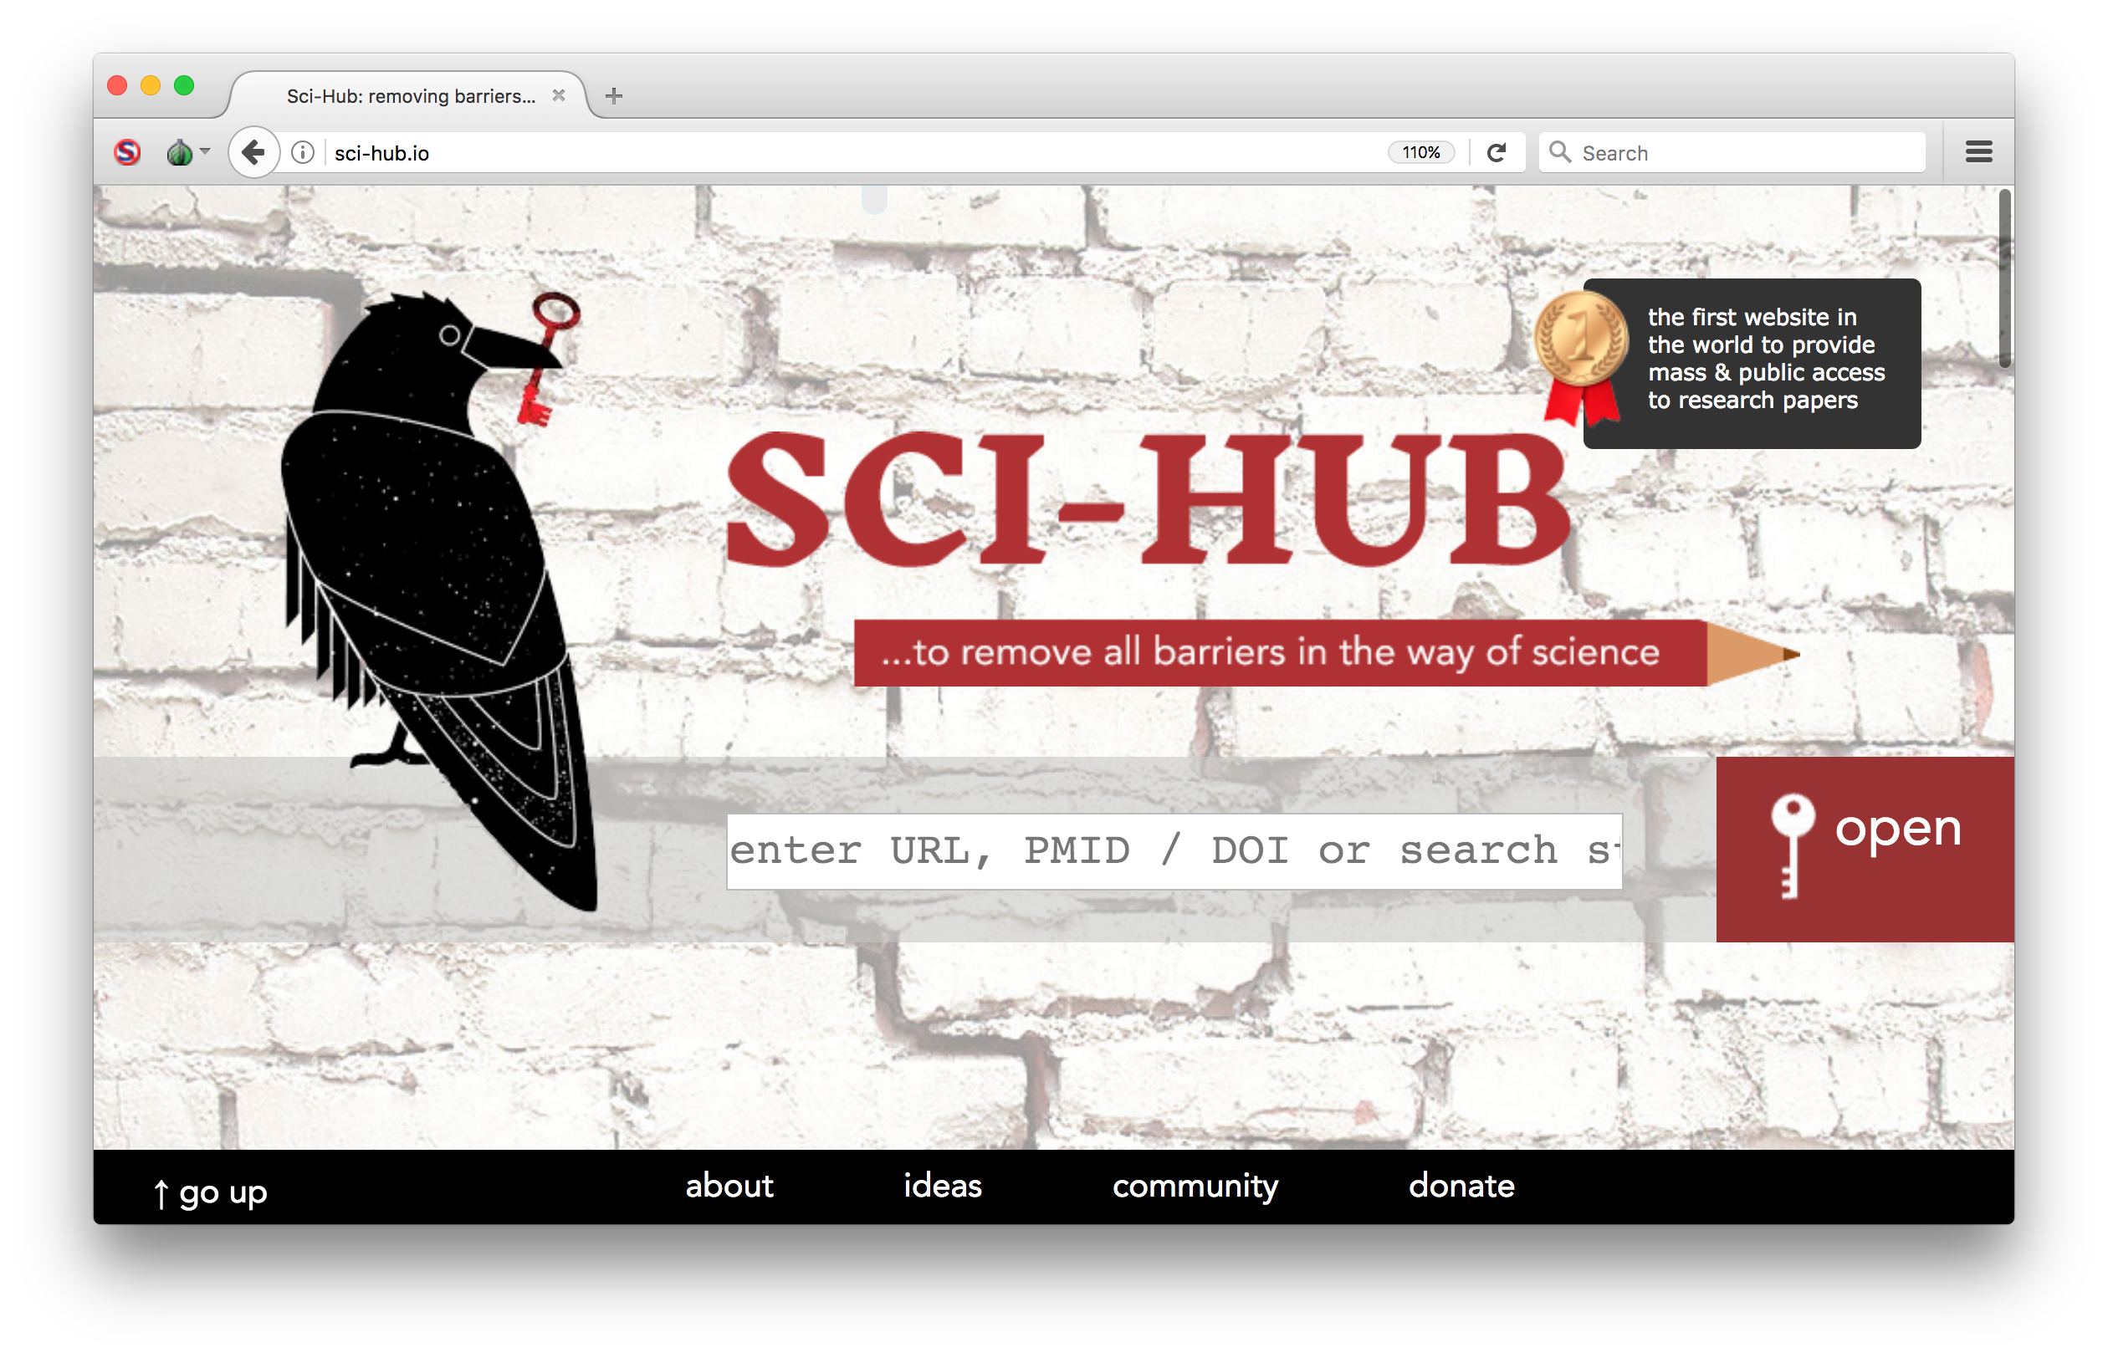
Stephen Reid McLaughlin / @SteveMcLaugh
Notes:
Currently over 64 million texts

Slide 19

Alexandra Elbakyan
https://vk.com/alexandra.elbakyan
Stephen Reid McLaughlin / @SteveMcLaugh
Notes:
Currently over 64 million texts

Slide 20
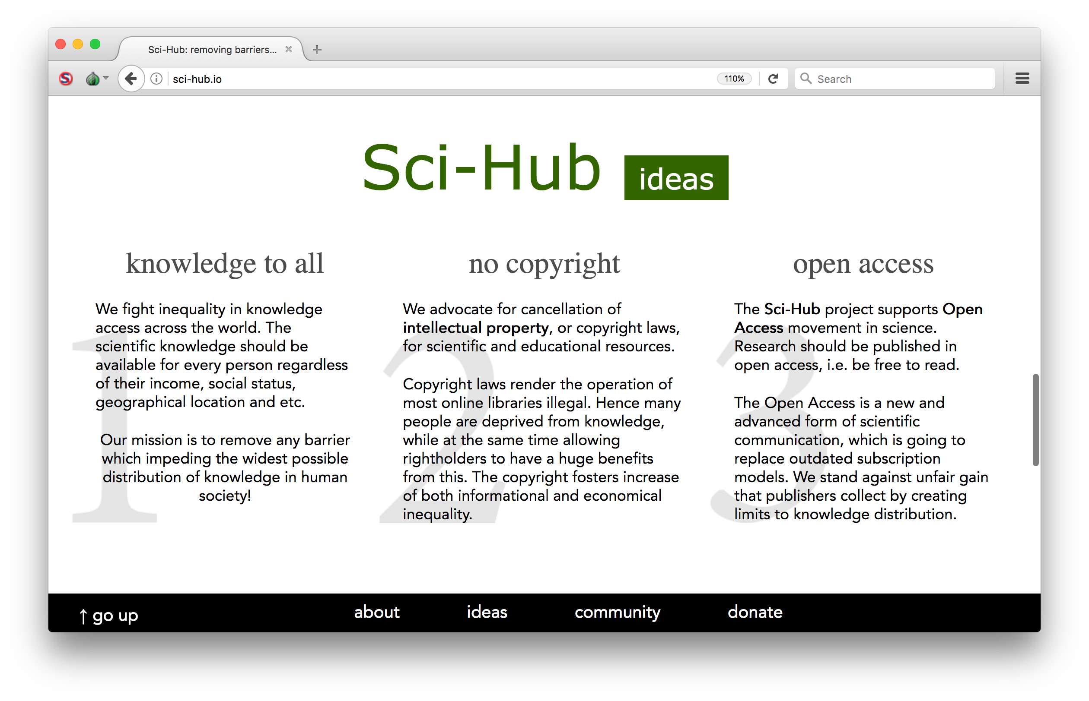
Stephen Reid McLaughlin / @SteveMcLaugh

Slide 21
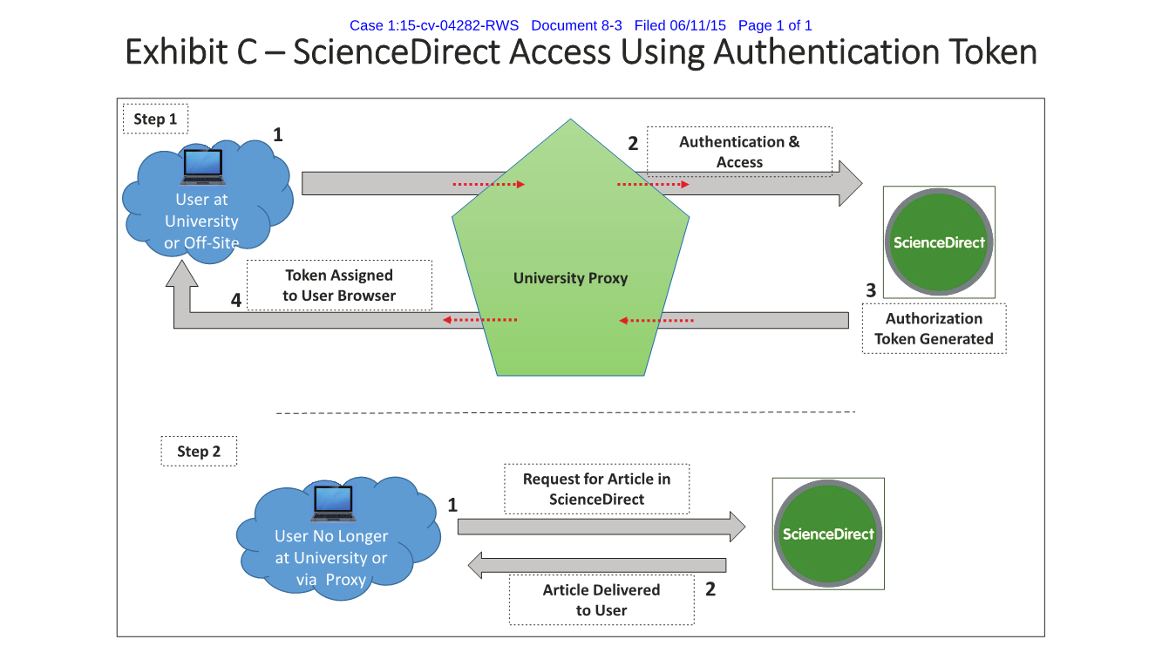
Elsevier et al. v. Sci-Hub et al., 2015
Stephen Reid McLaughlin / @SteveMcLaugh
Notes:
Declaration of Anthony Woltermann in Support of Plaintiffs’ Application an Order Authorizing Alternative Service of Process on Defendants and for Preliminary Injunction

Slide 22
Elsevier et al. v. Sci-Hub et al., 2015
Stephen Reid McLaughlin / @SteveMcLaugh
Notes:
Declaration of Anthony Woltermann in Support of Plaintiffs’ Application an Order Authorizing Alternative Service of Process on Defendants and for Preliminary Injunction

Slide 23
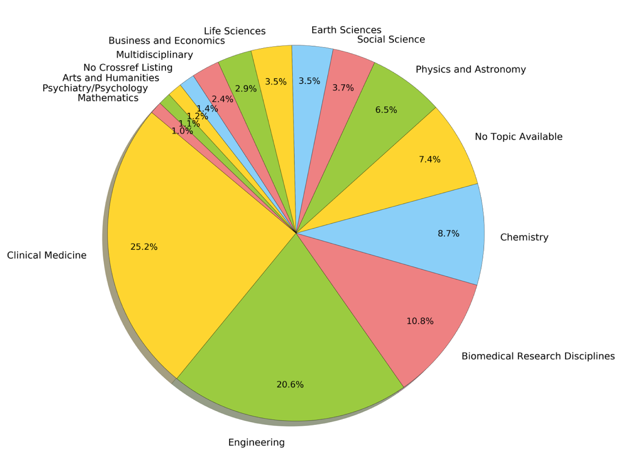
Fields most downloaded
from Sci-Hub in the US,
Sept. 2015 – Feb. 2016
25.2% Clinical Medicine
20.6% Engineering
10.8% Biomedical
8.7% Chemistry
…
1.4% Arts and Humanities
Gardner, McLaughlin, and Asher 2017
Stephen Reid McLaughlin / @SteveMcLaugh
Notes:
6 months of logs, starting in September 2014
1.5% of 20 million is 420,000
Using Pay it Forward

Slide 24
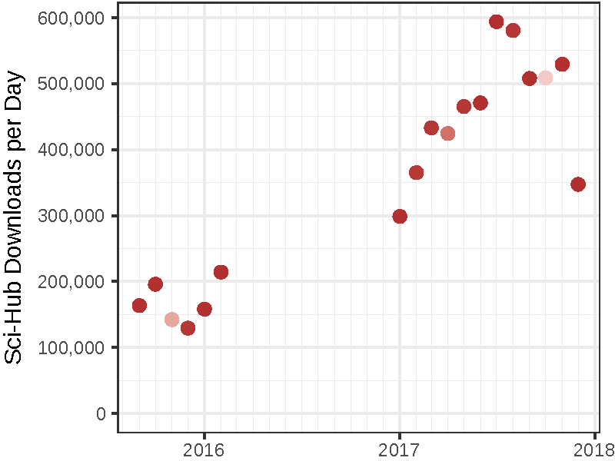
Himmelstein et al. 2018
Stephen Reid McLaughlin / @SteveMcLaugh

Slide 25
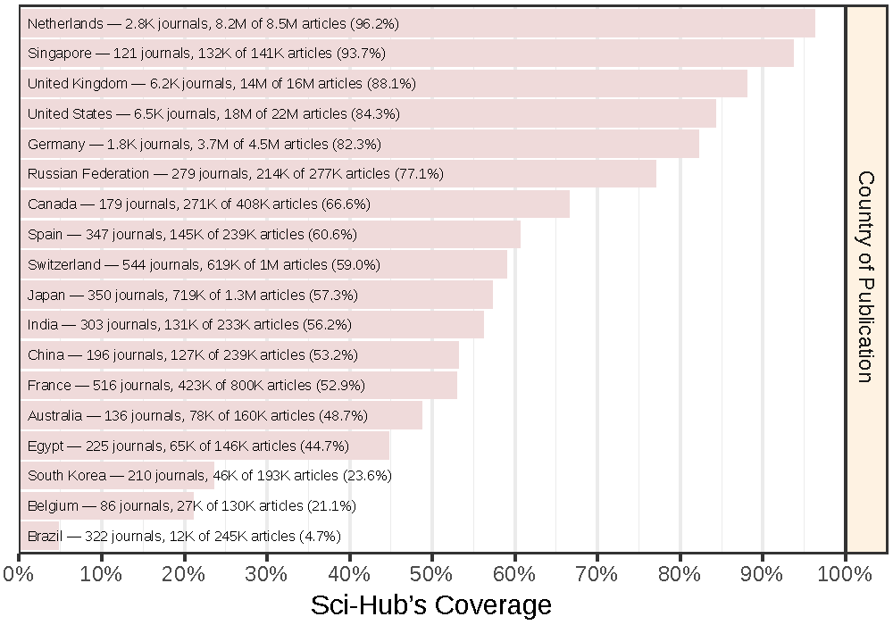
Himmelstein et al. 2018
Stephen Reid McLaughlin / @SteveMcLaugh

Slide 26
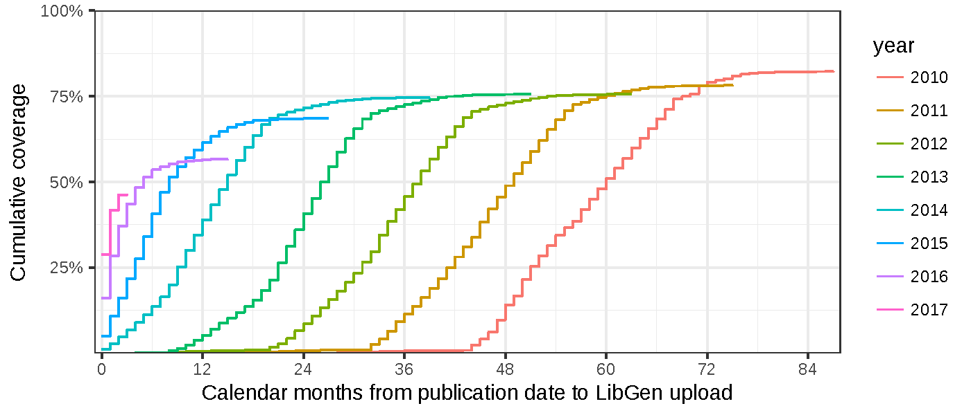
Himmelstein et al. 2018
Stephen Reid McLaughlin / @SteveMcLaugh

Slide 27
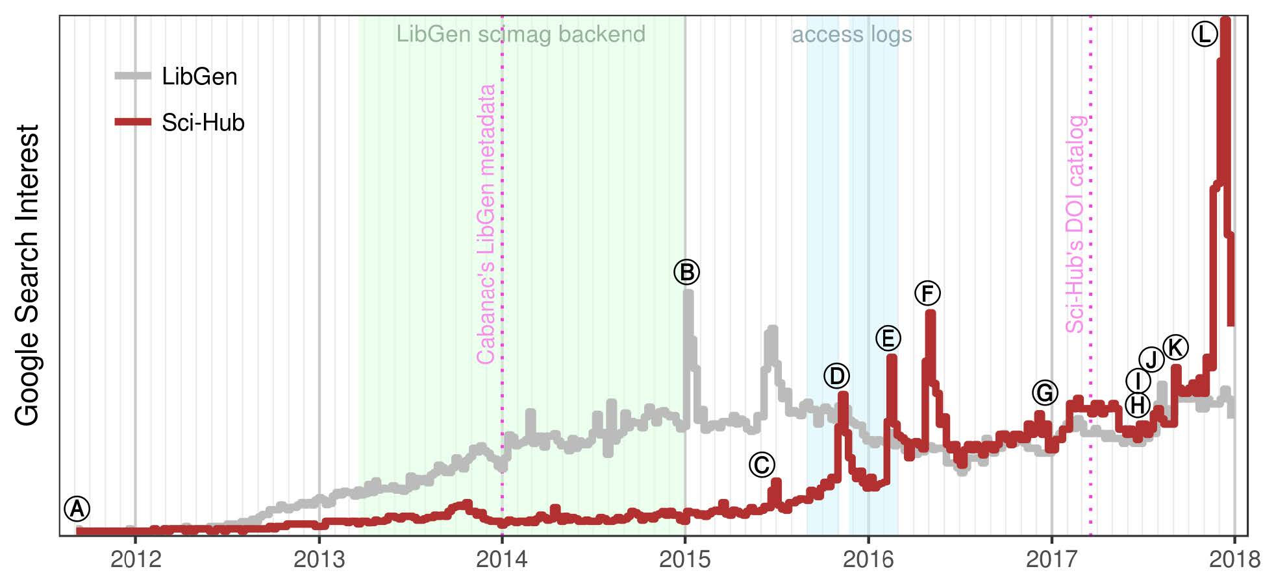
Himmelstein et al. 2018
Stephen Reid McLaughlin / @SteveMcLaugh
Notes:
Figure 1, The ⓛⓔⓣⓣⓔⓡⓢ refer to the following events:
Ⓐ Created by Alexandra Elbakyan, the Sci-Hub website goes live on September 5, 2011.
Ⓑ Several LibGen domains go down when their registration expires, allegedly due to a
longtime site administrator passing away from cancer [36].
Ⓒ Elsevier files a civil suit against Sci-Hub and LibGen — at the respective domains scihub.
org and libgen.org — in the U.S. District Court for the Southern District of New York
[37,38]. The complaint seeks a “prayer for relief” that includes domain name seizure,
damages, and “an order disgorging Defendants’ profits”.
Ⓓ Elsevier is granted a preliminary injunction to suspend domain names and restrain the site
operators from distributing Elsevier’s copyrighted works [39,40]. Shortly after, Sci-Hub and
LibGen resurface at alternative domains outside of U.S. court jurisdiction, including on the
dark web [26,41].
Ⓔ The article “Meet the Robin Hood of Science” by Simon Oxenham spurs a wave of
attention and news coverage on Sci-Hub and Alexandra Elbakyan [42], culminating in The
New York Times asking “Should all research papers be free?” [43].
Ⓕ The article “Who’s downloading pirated papers? Everyone” by John Bohannon shows Sci-
Hub is used worldwide, including in developed countries [44,45]. These findings spark debate
among scholars, with a large contingent of scientists supporting Sci-Hub’s mission [46,47].
Ⓖ Alexandra Elbakyan is named one of “Nature’s 10”, which featured “ten people who
mattered” in 2016 [48]. Written by Richard Van Noorden, the story profiles Alexandra and
includes an estimate that Sci-Hub serves “3% of all downloads from science publishers
worldwide.”
Ⓗ The court finds that Alexandra Elbakyan, Sci-Hub, and LibGen are “liable for willful
copyright infringement” in a default judgment, since none of the defendants answered
Elsevier’s complaint [49–51]. The court issues a permanent injunction and orders the
defendants to pay Elsevier $15 million, or $150,000 for each of 100 copyrighted works. The
statutory damages, which the defendants do not intend to pay, now bear interest.
Ⓘ The American Chemical Society files suit against Sci-Hub in the U.S. District Court for the
Eastern District of Virginia. Their “prayer for relief” requests that Internet search engines and
Internet service providers “cease facilitating access” to Sci-Hub [52,53].
Ⓙ The version 1 preprint of this study is published [54], generating headlines such as
Science’s “subscription journals are doomed” [55] and Inside Higher Ed’s “Inevitably Open”
[56].
Ⓚ Sci-Hub blocks access to Russian IP addresses due to disputes with the Russian Scientific
establishment and the naming of a newly discovered parasitoid wasp species, Idiogramma
elbakyanae, after Alexandra Elbakyan [57]. Four days later, Sci-Hub restores access after
receiving “many letters of support from Russian researchers” [59].
Ⓛ The court rules on the American Chemical Society suit, ordering Sci-Hub to pay $4.8
million in damages and that “any person or entity in active concert or participation” with Sci-
Hub “including any Internet search engines, web hosting and Internet service providers,
domain name registrars, and domain name registries, cease facilitating access” [60,61].
Within five weeks, the domains sci-hub.io, sci-hub.ac, sci-hub.cc, and sci-hub.bz were
suspended by their respective domain name registries [62], leaving only the Tor hidden
service and several newly-registered/revealed domains in operation.

Slide 28
Domain Whac-a-Mole
sci-hub.org sci-hub.cc sci-hub.ac sci-hub.io sci-hub.bz sci-hub.biz
sci-hub.hk sci-hub.la sci-hub.mn sci-hub.name sci-hub.tw sci-hub.tv
Stephen Reid McLaughlin / @SteveMcLaugh

Slide 29
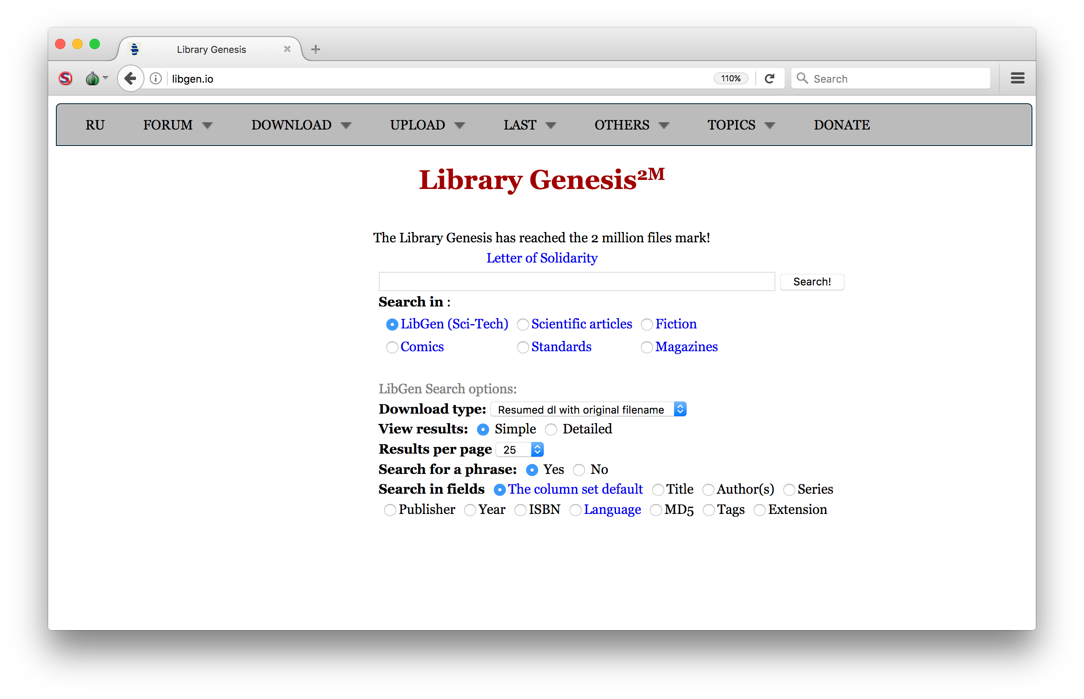
Stephen Reid McLaughlin / @SteveMcLaugh
Notes:
51% English
34% Russian
Followed by German, Ukranian, French, and Spanish

Slide 30
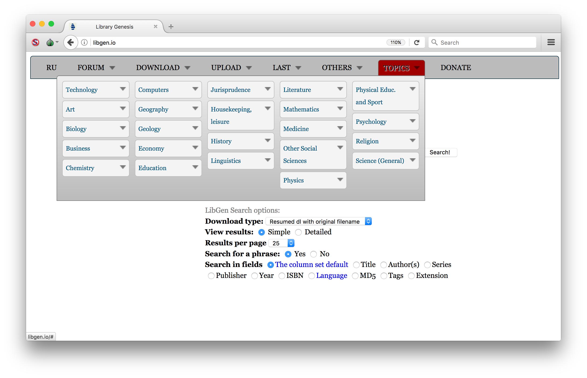
Stephen Reid McLaughlin / @SteveMcLaugh
Notes:
51% English
34% Russian
Followed by German, Ukranian, French, and Spanish

Slide 31
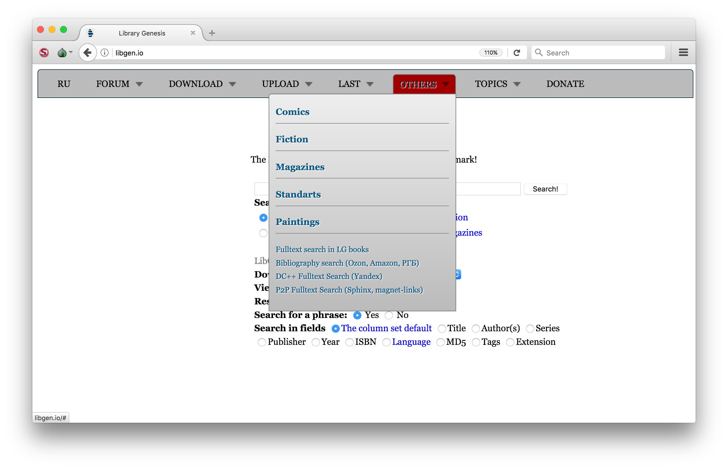
Stephen Reid McLaughlin / @SteveMcLaugh

Slide 32
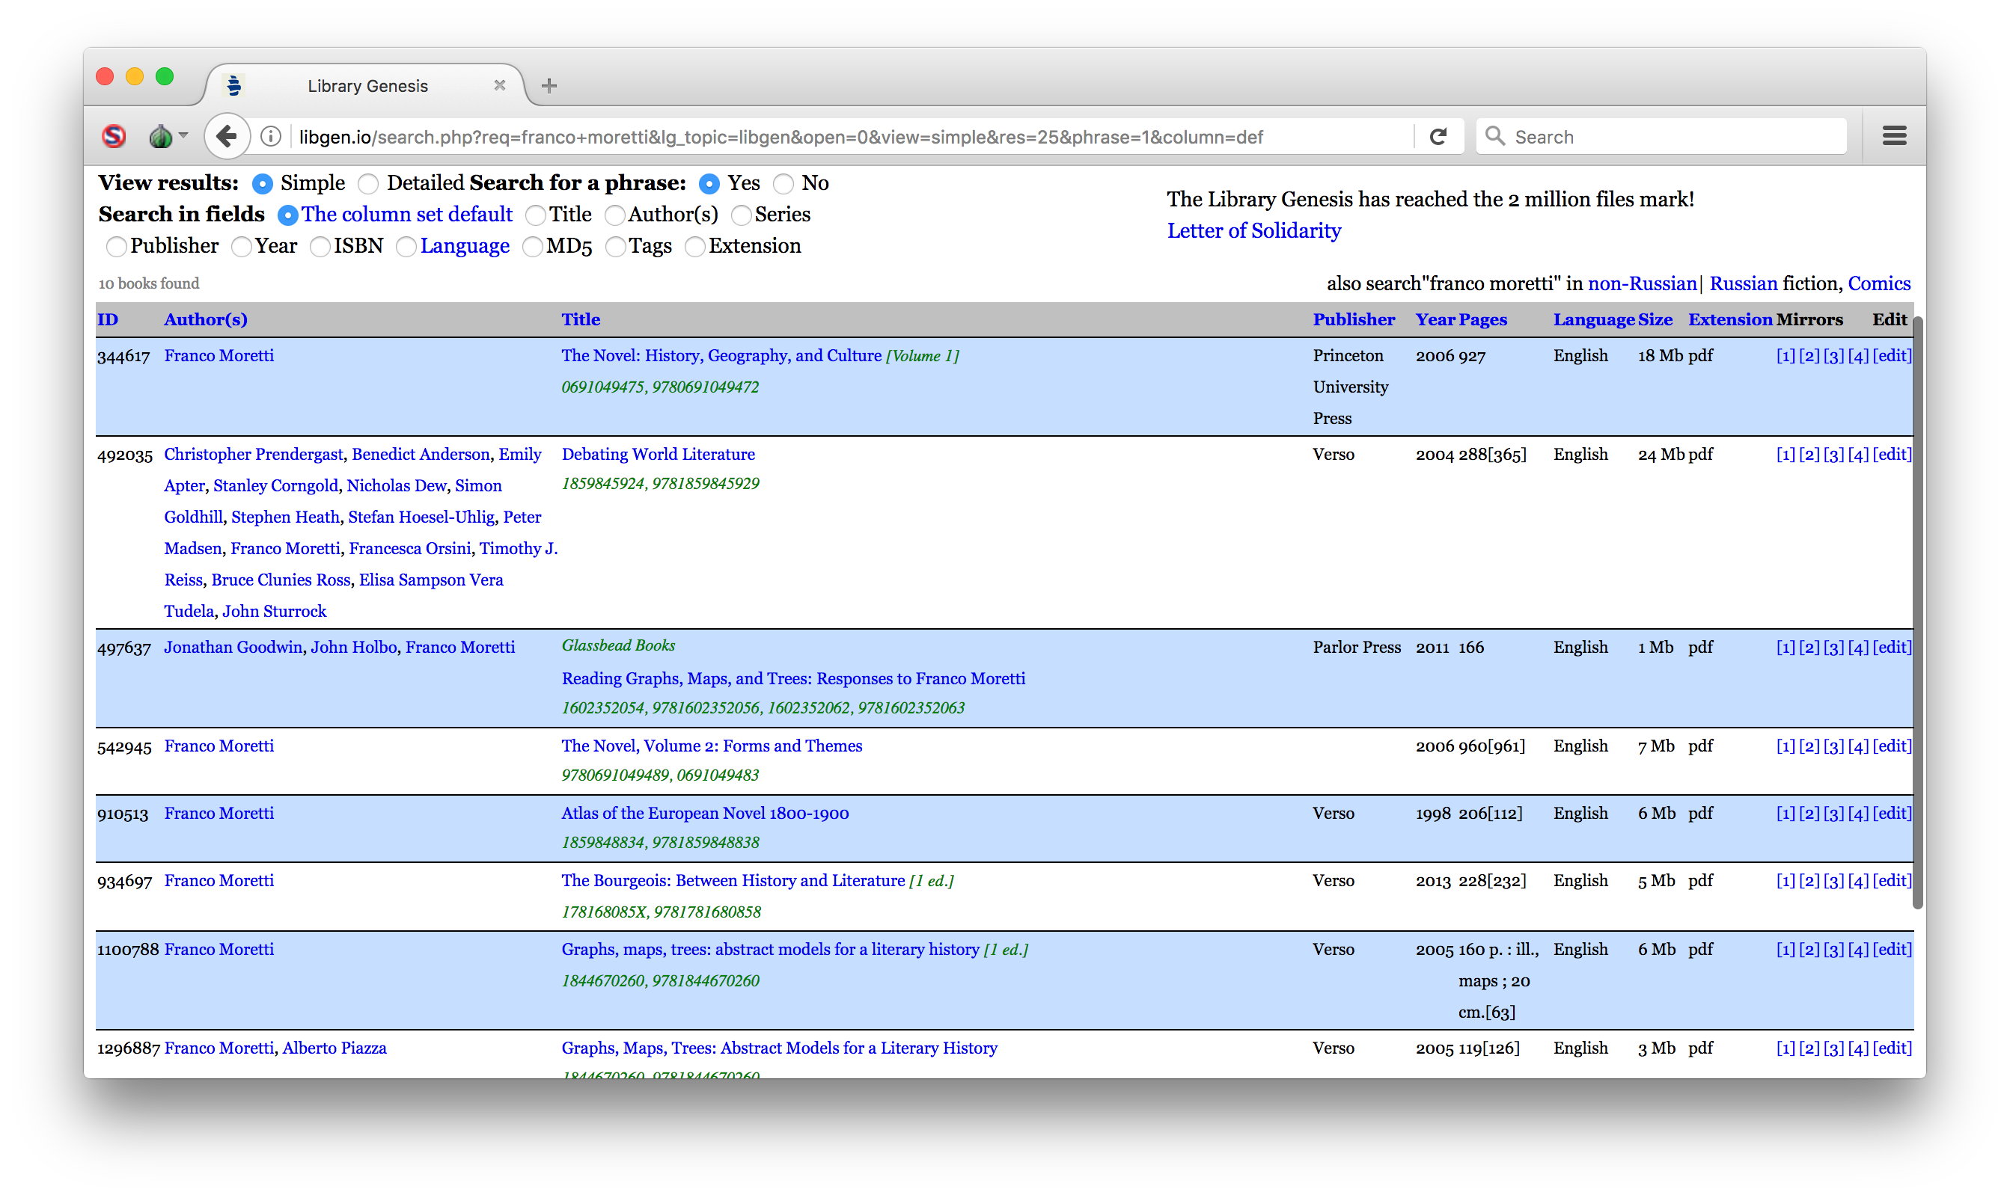
Stephen Reid McLaughlin / @SteveMcLaugh

Slide 33
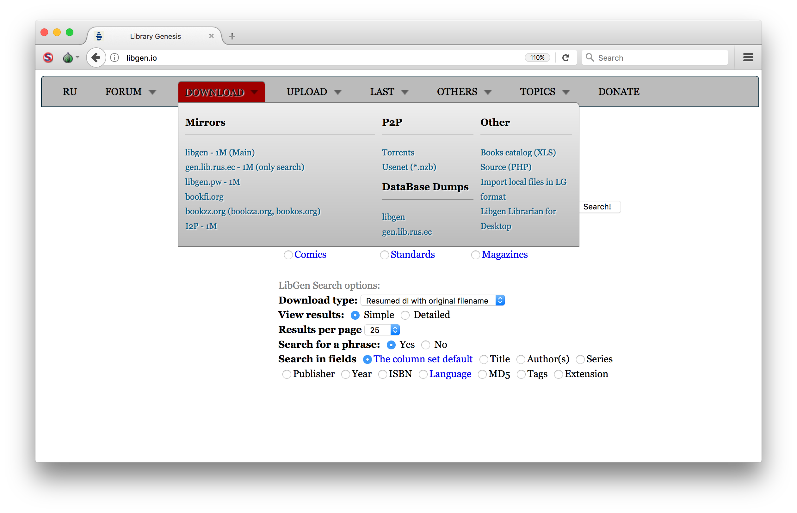
Stephen Reid McLaughlin / @SteveMcLaugh

Slide 34
Topic | Titles in Library Genesis
[No Topic Listed] | 1,102,929
Engineering | 110,023
Mathematics | 95,547
History | 91,773
Linguistics | 71,801
Computers | 67,221
Education | 54,762
Biology | 46,968
Psychology | 45,368
Other Social Sciences | 43,594
Physics | 40,829
Medicine | 37,449
Economy | 31,145
Housekeeping, leisure | 27,367
Chemistry | 25,605
Art | 25,027
Business | 24,387
Religion | 22,645
Jurisprudence | 22,585
Literature | 18,661
Top 20 topic labels in
Library Genesis metadata
(including duplicates)
Stephen Reid McLaughlin / @SteveMcLaugh
Notes:
Their metadata is messy, but it isn’t the end of the world. Their users know what they’re looking for.

Slide 35
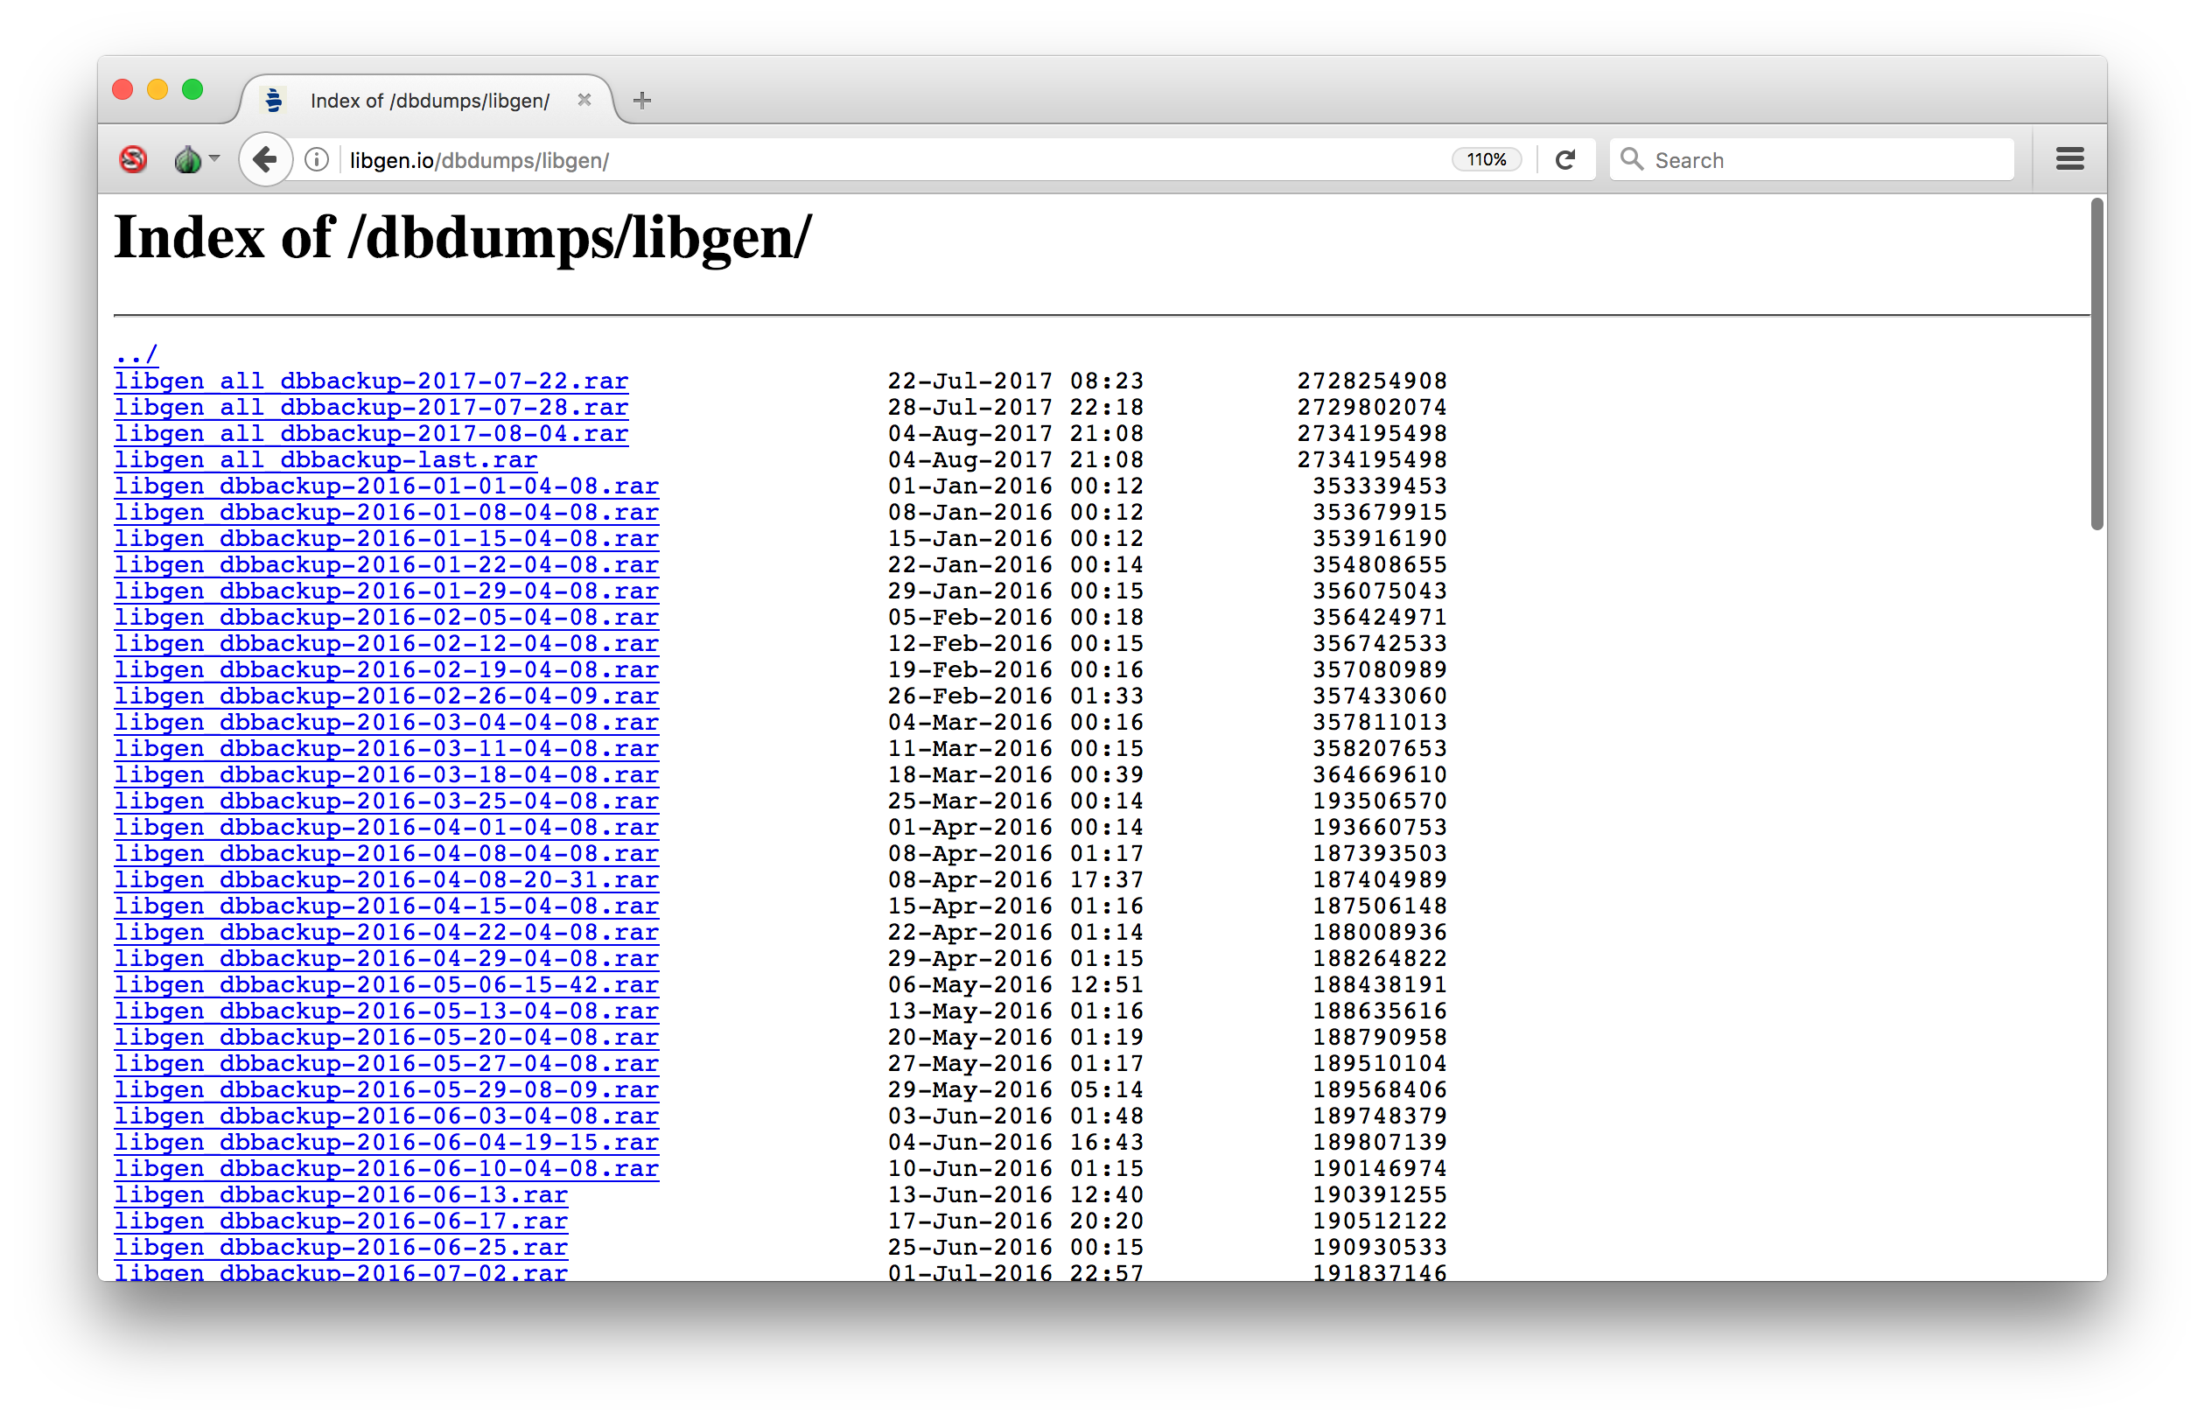
Stephen Reid McLaughlin / @SteveMcLaugh

Slide 36
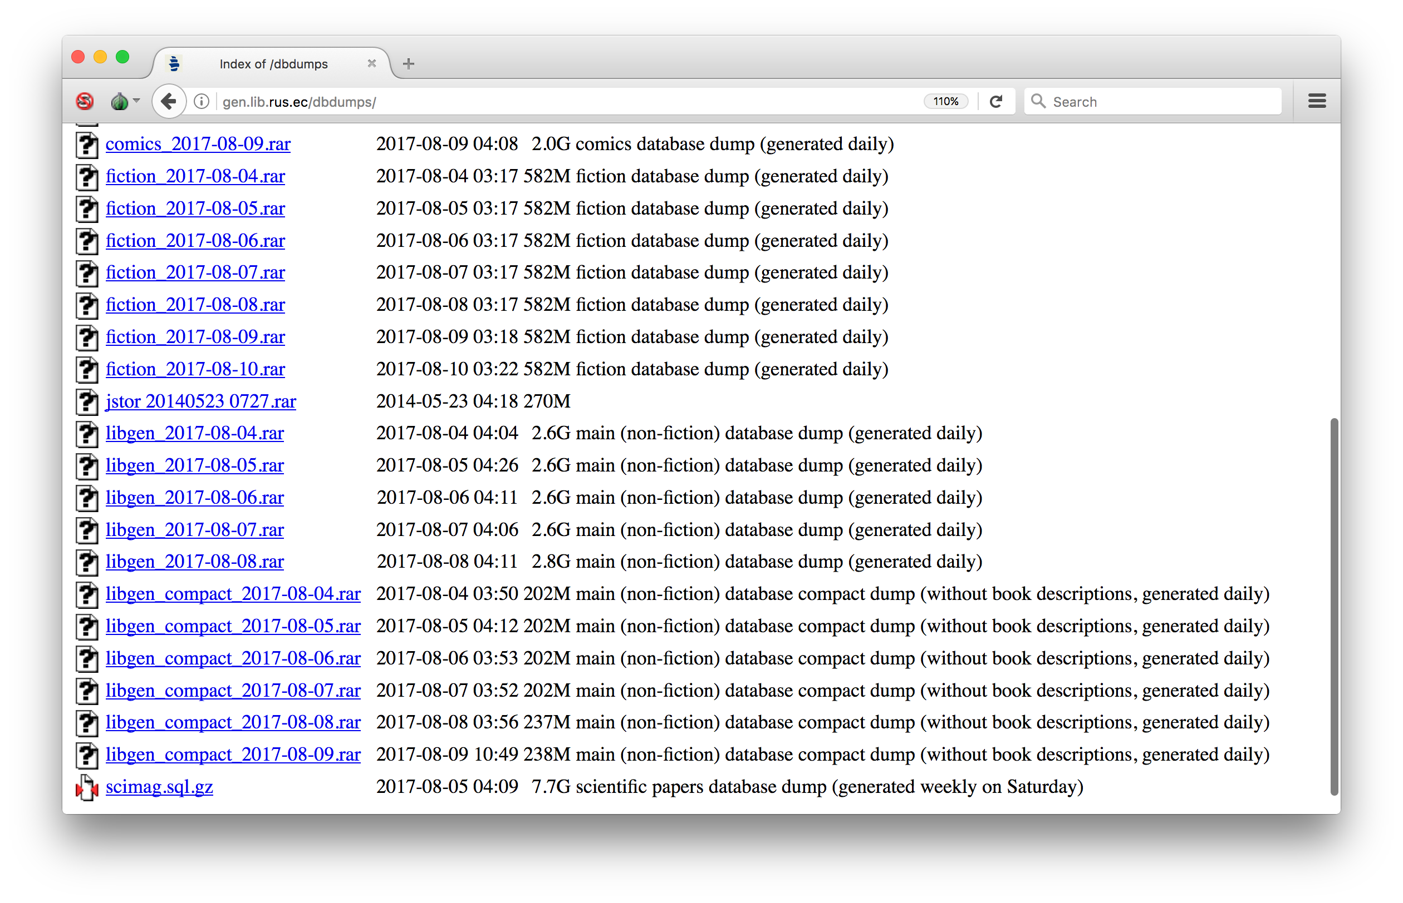
Stephen Reid McLaughlin / @SteveMcLaugh

Slide 37
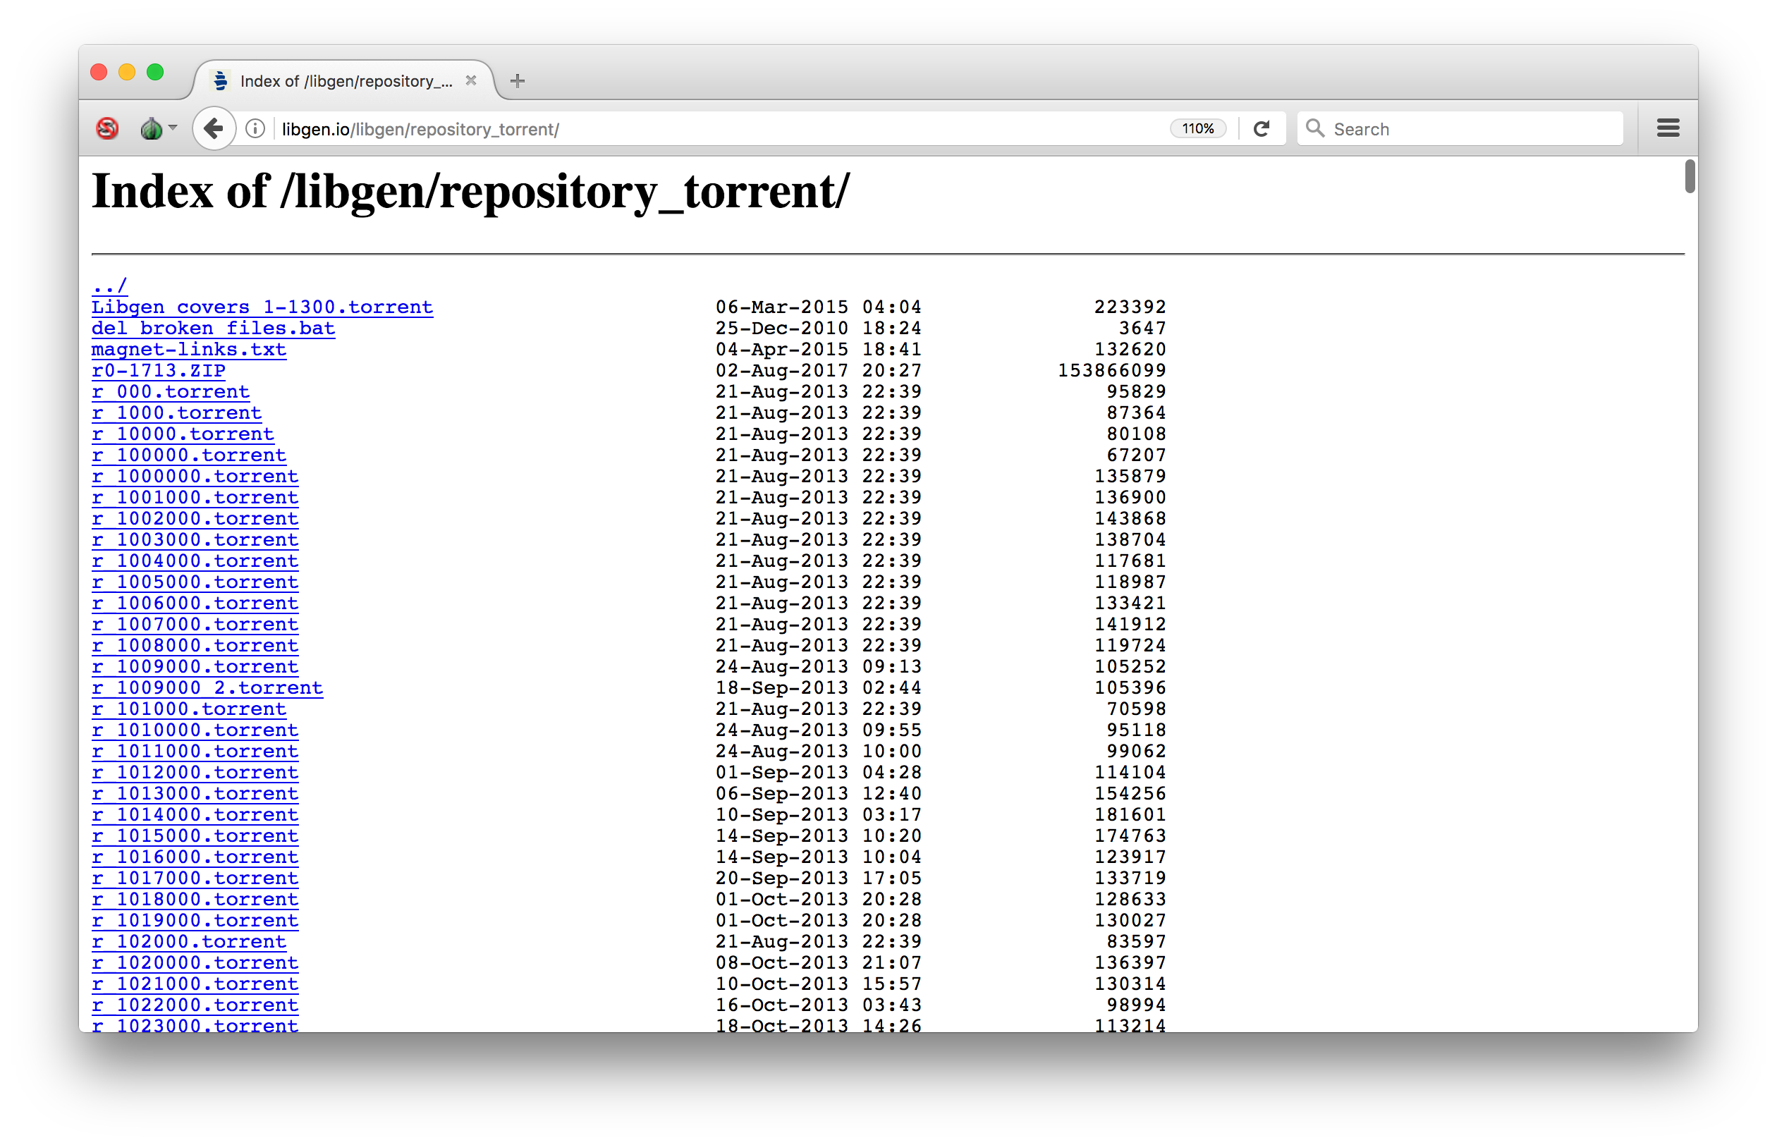
Stephen Reid McLaughlin / @SteveMcLaugh
Notes:
[download transmission-cli and demonstrate transmission-show]

Slide 38
[screen cap of trackers.txt]
Stephen Reid McLaughlin / @SteveMcLaugh

Slide 39
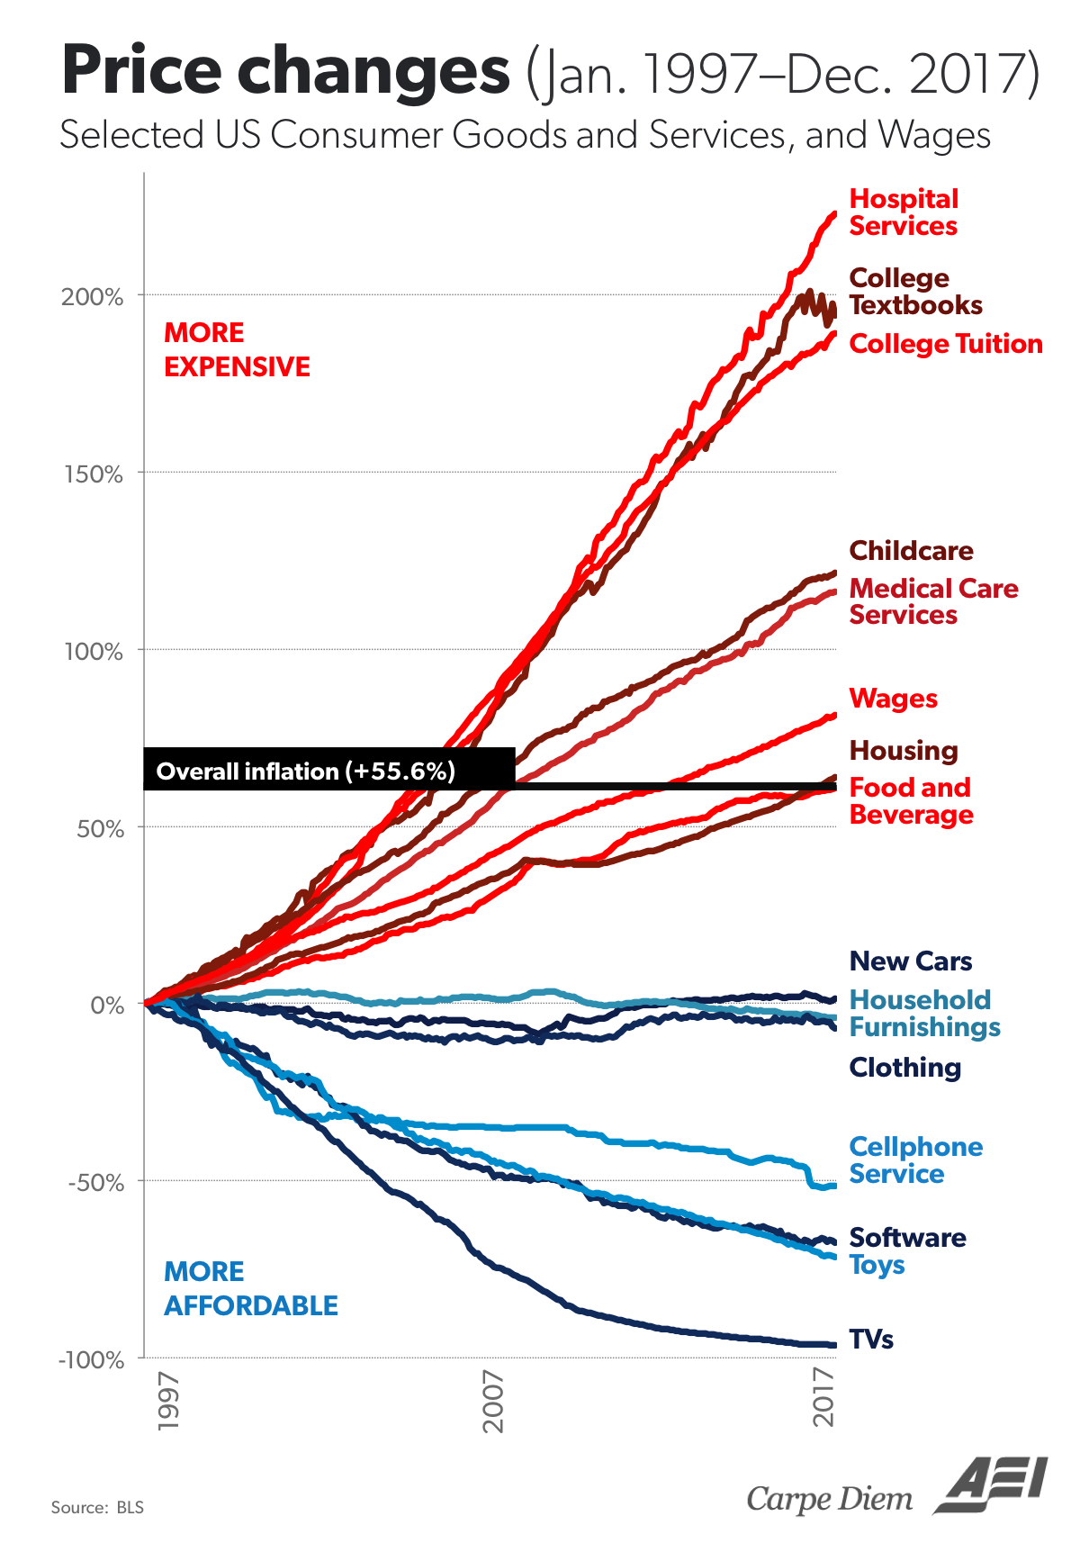
Perry 2018
Stephen Reid McLaughlin / @SteveMcLaugh
Notes:
https://www.aei.org/publication/chart-of-the-day-century-price-changes-1997-to-2017/?utm_content=buffere2f75&utm_medium=social&utm_source=twitter
Mark J. Perry@Mark_J_Perry
February 2, 2018

Slide 40
Shadow libs as a useful model
Stephen Reid McLaughlin / @SteveMcLaugh
Notes:
2. We can look to it as a model.
Repertoire
“repertoire of contention” from Tilly –
We’re used to best practices, building (relatively) stable systems
… but that’s not the case here. There is an expectation that any single group will give up control at some point in the future (possibly sooner rather than later).

Slide 41
Shadow libs as a useful model
Collaborative work with limited resources
Stephen Reid McLaughlin / @SteveMcLaugh
Notes:
2. We can look to it as a model.
Repertoire
“repertoire of contention” from Tilly –
We’re used to best practices, building (relatively) stable systems
… but that’s not the case here. There is an expectation that any single group will give up control at some point in the future (possibly sooner rather than later).

Slide 42
Shadow libs as a useful model
Collaborative work with limited resources
Rapid institutional life cycle
Stephen Reid McLaughlin / @SteveMcLaugh
Notes:
2. We can look to it as a model.
Repertoire
“repertoire of contention” from Tilly –
We’re used to best practices, building (relatively) stable systems
… but that’s not the case here. There is an expectation that any single group will give up control at some point in the future (possibly sooner rather than later).

Slide 43
Shadow libs as a useful model
Collaborative work with limited resources
Rapid institutional life cycle
Suppressed institutional ego
Stephen Reid McLaughlin / @SteveMcLaugh
Notes:
2. We can look to it as a model.
Repertoire
“repertoire of contention” from Tilly –
We’re used to best practices, building (relatively) stable systems
… but that’s not the case here. There is an expectation that any single group will give up control at some point in the future (possibly sooner rather than later).

Slide 44
Shadow libs as a useful model
Collaborative work with limited resources
Rapid institutional life cycle
Suppressed institutional ego
Diversity of practices
Stephen Reid McLaughlin / @SteveMcLaugh
Notes:
2. We can look to it as a model.
Repertoire
“repertoire of contention” from Tilly –
We’re used to best practices, building (relatively) stable systems
… but that’s not the case here. There is an expectation that any single group will give up control at some point in the future (possibly sooner rather than later).

Slide 45
Shadow librarianship in practice
Book scanning (Medak and Sekulić 2014)
Decentralized online sharing (Mars, Zarroug, and Medak 2015)
Evading digital forensics (Mazurov 2015)
Division of labor (Williwaw et al. 2013)
Stephen Reid McLaughlin / @SteveMcLaugh
Notes:
“repertoire of contention” – (Tilly 2002)
Close to direct action
a range of self-consciousness (at least in their writings) with respect to the political meaning of these actions

Slide 46
“[A] lawsuit isn’t going to stop it, nor is there any obvious technical means. Everyone should be thinking about the fact that this is here to stay.”
— Peter Suber, quoted in Bohannon 2016
Stephen Reid McLaughlin / @SteveMcLaugh
Notes:
- possibly true for the near future
but I think it’s exactly the wrong way to think about it
can’t take it for granted
many thousands of active contributors

Slide 47
On-the-fly data sharing
https://hostb.org
A minimal file locker with a command-line interface
https://file.pizza
Temporary browser-to-browser transfer; doesn’t work on mobile
https://mega.nz
Offers full encryption
https://pastebin.com
Copy-and-paste plaintext sharing
Stephen Reid McLaughlin / @SteveMcLaugh

Slide 48

ABUT
Always
https://www.torproject.org
Stephen Reid McLaughlin / @SteveMcLaugh
Notes:
https://commons.wikimedia.org/wiki/File:Tor-logo-2011-flat.svg

Slide 49
ABUT
Always
Be
https://www.torproject.org
Stephen Reid McLaughlin / @SteveMcLaugh
Notes:
https://commons.wikimedia.org/wiki/File:Tor-logo-2011-flat.svg

Slide 50
ABUT
Always
Be
Using
https://www.torproject.org
Stephen Reid McLaughlin / @SteveMcLaugh
Notes:
https://commons.wikimedia.org/wiki/File:Tor-logo-2011-flat.svg

Slide 51
ABUT
Always
Be
Using
Tor
https://www.torproject.org
Stephen Reid McLaughlin / @SteveMcLaugh
Notes:
https://commons.wikimedia.org/wiki/File:Tor-logo-2011-flat.svg

Slide 52
HTHICYNI
Have
Tor
Handy
In
Case
You
Need
It
https://www.torproject.org
Stephen Reid McLaughlin / @SteveMcLaugh
Notes:
https://commons.wikimedia.org/wiki/File:Tor-logo-2011-flat.svg

Slide 53
BRTTABDM
But
Remember
That
Tor
And
BitTorrent
Don’t
Mix
https://www.torproject.org
Stephen Reid McLaughlin / @SteveMcLaugh
Notes:
https://commons.wikimedia.org/wiki/File:Tor-logo-2011-flat.svg

Slide 54
Stephen Reid McLaughlin / @SteveMcLaugh

Slide 55
The Single Big Collection
Zinester
Stephen Reid McLaughlin / @SteveMcLaugh

Slide 56
Stephen Reid McLaughlin / @SteveMcLaugh

Slide 57
Stephen Reid McLaughlin / @SteveMcLaugh

Slide 58
Stephen Reid McLaughlin / @SteveMcLaugh

Slide 59
Stephen Reid McLaughlin / @SteveMcLaugh

Slide 60
Stephen Reid McLaughlin / @SteveMcLaugh

Slide 61
Stephen Reid McLaughlin / @SteveMcLaugh

Slide 62
Stephen Reid McLaughlin / @SteveMcLaugh

Slide 63
Research Methods
15 formal interviews with scholars, participants, site operators
Sci-Hub usage logs
LibGen metadata dumps
Collecting commentary in news media & blogs
Stephen Reid McLaughlin / @SteveMcLaugh
Notes:
2. We can look to it as a model.
Repertoire
“repertoire of contention” from Tilly –
We’re used to best practices, building (relatively) stable systems
… but that’s not the case here. There is an expectation that any single group will give up control at some point in the future (possibly sooner rather than later).

Slide 64
Lessons
Stephen Reid McLaughlin / @SteveMcLaugh

Slide 65
Longevity lies in numbers.
Stephen Reid McLaughlin / @SteveMcLaugh

Slide 66
Obscurity lies in numbers.
Stephen Reid McLaughlin / @SteveMcLaugh

Slide 67
Anyone should be able to edit the collection and adapt it to their local interests.
Stephen Reid McLaughlin / @SteveMcLaugh

Slide 68
Anyone should be able to edit the collection and adapt it to their local interests.
(I may not share your taste.)
Stephen Reid McLaughlin / @SteveMcLaugh

Slide 69
De gustibus non est disputandum.
Stephen Reid McLaughlin / @SteveMcLaugh

Slide 70
Other lessons …
Stephen Reid McLaughlin / @SteveMcLaugh

Slide 71
Today’s goal:
Create a distributed copy
of (part of) UbuWeb’s
collection.
Stephen Reid McLaughlin / @SteveMcLaugh

Slide 72
Possible roles: Table Maestro - Responsible for combining and spot-checking master metadata table, using Google Sheets or git. Table Designer - Someone who knows pandas (or advanced Excel). CLI DL BB - Someone familiar with wget and/or curl. Function Librarian - Someone with programming experience who can help team members streamline their code, as well as identifying functions and snippets that might be useful to others. Web Researcher (a.k.a. the Wikipedia wrangler) - Responsible for cross-checking unknown or disputed details in the metadata and keeping a list of citations. Use Google Docs/Etherpad/whatever to run a request queue. The Debugger - Someone with programming experience who can help people iron out kinks. Table Proofers (one or two people) - Scans through the master metadata table (on Google Docs or GitHub) and corrects mistakes by hand. The Prospector - Someone who searches for other collections that may be relevant (e.g., YouTube and Vimeo channels), as well as tracking down oddities. youtube-dl is your friend.
Stephen Reid McLaughlin / @SteveMcLaugh

Slide 73

Name?
Stephen Reid McLaughlin / @SteveMcLaugh
Notes:
"repertoires of archiving", which connects to repertoires in social movements
We're used to talking about best practices in Libraries, we're shooting for stable systems.
Here it's taken for granted that organizations will change rapidly, probably sooner than later

Slide 74

Format?
Stephen Reid McLaughlin / @SteveMcLaugh
Notes:
"repertoires of archiving", which connects to repertoires in social movements
We're used to talking about best practices in Libraries, we're shooting for stable systems.
Here it's taken for granted that organizations will change rapidly, probably sooner than later

Slide 75
Running a throwie server
Stephen Reid McLaughlin / @SteveMcLaugh

Slide 76
Running a throwie server
(i.e., a VPS)
Stephen Reid McLaughlin / @SteveMcLaugh

Slide 77
throwie = throwaway
Stephen Reid McLaughlin / @SteveMcLaugh

Slide 78

LED
throwies
https://www.slideshare.net/ilariadefilippo/lets-make-a-led-throwie-ggdmilano28
Stephen Reid McLaughlin / @SteveMcLaugh
Notes:
https://www.slideshare.net/ilariadefilippo/lets-make-a-led-throwie-ggdmilano28
I first saw these on the MIT campus, really high up on one of those swooping steel sculptures.

Slide 79
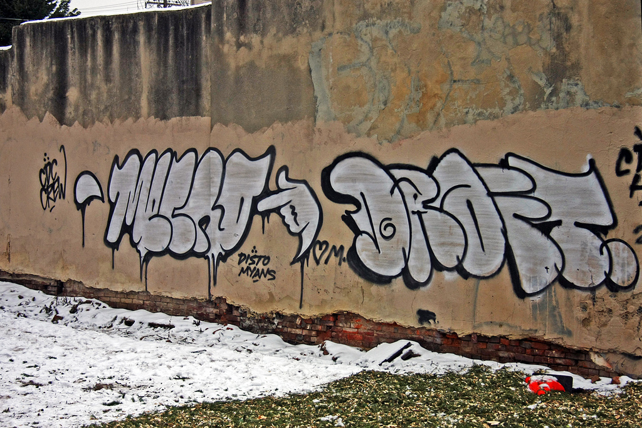
Graf throwies in Philly
https://www.flickr.com/photos/damonabnormal/5347455185
Stephen Reid McLaughlin / @SteveMcLaugh
Notes:
This is what Mecro can do in *probably* two minutes or less.
https://www.flickr.com/photos/damonabnormal/5347455185
(Actually known as a throwup.)

Slide 80
A throwie account on Reddit
The_url
Stephen Reid McLaughlin / @SteveMcLaugh

Slide 81
Meaningful preservation means you have access.
Stephen Reid McLaughlin / @SteveMcLaugh
Notes:
I just got forced to withdraw from academia. As of mid-March, for the first time in 14 years, I will have legal access to *zero* paywalled journals, or monographs on databases, or a serious library.
At the moment I buy a lot of books because my wife is a ruthless capitalist, but for most of my life I’ve been … not poor. I’ve been on food stamps in the US, but I’ve never been starving. But broke, definitely.
Actually, when I think of it, my wife is a kind, caring, and gentle capitalist. But yeah, she’s part of the system.ds

Slide 82
Reliable access means it’s on your hard drive.
Stephen Reid McLaughlin / @SteveMcLaugh
Notes:
As Kenny has said, it’s still the Summer of Love as far as file sharing, as far as Internet freedom. But that could be coming to an end. Things have sure gotten more difficult in recent years.
What kind of culture do you really care about?

Slide 83

What culture can’t you live without?
Stephen Reid McLaughlin / @SteveMcLaugh
Notes:
"repertoires of archiving", which connects to repertoires in social movements
We're used to talking about best practices in Libraries, we're shooting for stable systems.
Here it's taken for granted that organizations will change rapidly, probably sooner than later

Slide 84
Server setup commands
ufw allow 8889 docker pull stevemclaugh/scrape-kit
docker run --name scrape_kit -ti -p 8889:8889 --volume /sharedfolder/:/sharedfolder/ stevemclaugh/scrape-kit
Stephen Reid McLaughlin / @SteveMcLaugh

Slide 85
[[screen caps of the process of setting up a server in Terminal]]
Stephen Reid McLaughlin / @SteveMcLaugh

Slide 86
Running Transmission
on a Throwie Server
Stephen Reid McLaughlin / @SteveMcLaugh

Slide 87
Scraping Ubu
Stephen Reid McLaughlin / @SteveMcLaugh
Notes:
I could ask Kenny for the current FTP login, but not everyone is so lucky.

Slide 88
Media files first,
then metadata
Publishing the Unpublishable
Stephen Reid McLaughlin / @SteveMcLaugh

Slide 89
A thoughtful, manual
recursive scrape
UbuWeb Film
Stephen Reid McLaughlin / @SteveMcLaugh

Slide 90
An obfuscatory
scrape using wget
UbuWeb Visual Poetry
Stephen Reid McLaughlin / @SteveMcLaugh

Slide 91
Works Cited
Bodó, Balázs. 2015. “Libraries in the Post-Scarcity Era.” In Copyrighting Creativity: Creative Values, Cultural Heritage Institutions and Systems of Intellectual Property, edited by Helle Porsdam. Farnham, Surrey, UK ; Burlington, VT: Ashgate. http://dare.uva.nl/record/1/445112
———. 2016. “Pirates in the Library–An Inquiry into the Guerilla Open Access Movement.” In 8th Annual Workshop of the International Society for the History and Theory of Intellectual Property, CREATe, University of Glasgow, UK. http://papers.ssrn.com/sol3/papers.cfm?abstract_id=2816925
Bohannon, John and Alexandra Elbakyan. “Data from: Who’s Downloading Pirated Papers? Everyone.” April 28, 2016. http://datadryad.org/resource/doi:10.5061/dryad.q447c
Borgman, Christine L. Scholarship in the Digital Age: Information, Infrastructure, and the Internet. Cambridge, Mass: MIT Press, 2007.
Himmelstein​, Daniel, Ariel Romero, Jacob G. Levernier Thomas Anthony Munro, Stephen Reid McLaughlin, Bastian Greshake Tzovaras, and Casey S. Greene. 2018. "Sci-Hub Provides Access to Nearly All Scholarly Literature.” https://elifesciences.org/articles/32822
Liang, Lawrence. 2012. “Shadow Libraries.” E-Flux. http://www.e-flux.com/journal/shadow-libraries/
Mars, Marcell, Manar Zarroug, and Tomislav Medak. 2015. “Public Library.” In Public Library, edited by Tomislav Medak and Marcell Mars, 75–85. What, How & for Whom and Multimedia Institute.
Mazurov, Nikita. 2015. “Strategies for Unbridled Data Dissemination: An Emergency Operations Manual.” Goldsmiths, University of London. https://archive.org/details/StrategiesForUnbridledDataDisseminationAnEmergencyOperationsManual
Medak, Tomislav and Dubravka Sekulić. 2014. "Book Scanning and Post-Processing Manual Based on Public Library Overhead Scanner.”
Perry, Mark J. 2018. “Chart of the day (century?): Price changes 1997 to 2017.” AEIdeas. https://www.aei.org/publication/chart-of-the-day-century-price-changes-1997-to-2017/
Tenen, Dennis, and Maxwell Foxman. 2014. “Book Piracy as Peer Preservation.” Computational Culture, November. http://computationalculture.net/article/book-piracy-as-peer-preservation
Williwaw, yellowElephant, kfogel, and FreeDam. 2013. “The Open Access Guerilla Cookbook.” http://cryptome.org/2013/01/guerilla-open-access-cookbook.htm
Stephen Reid McLaughlin / @SteveMcLaugh
Notes:
“repertoire of contention” – (Tilly 2002)
Close to direct action
a range of self-consciousness (at least in their writings) with respect to the political meaning of these actions

Slide 92

Stephen Reid McLaughlin / @SteveMcLaugh

Slide 93
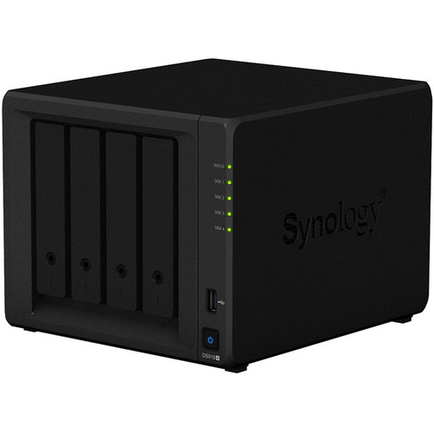
Stephen Reid McLaughlin / @SteveMcLaugh

Slide 94
Screen cap of r/datahoarder
Stephen Reid McLaughlin / @SteveMcLaugh

Slide 95
The only 2 RAID configurations that matter:
RAID 1
&
RAID 6
Stephen Reid McLaughlin / @SteveMcLaugh

Slide 96
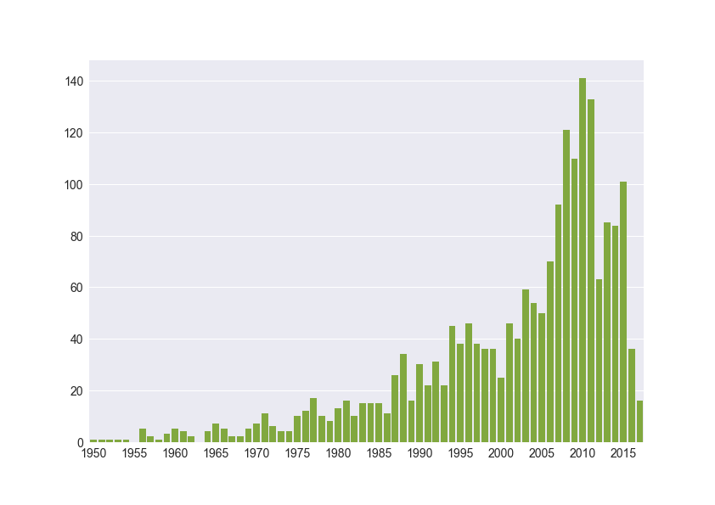
Titles in Library Genesis by Publication Year: University of Chicago Press
Stephen Reid McLaughlin / @SteveMcLaugh
Notes:
2005 books (deduped)

Slide 97
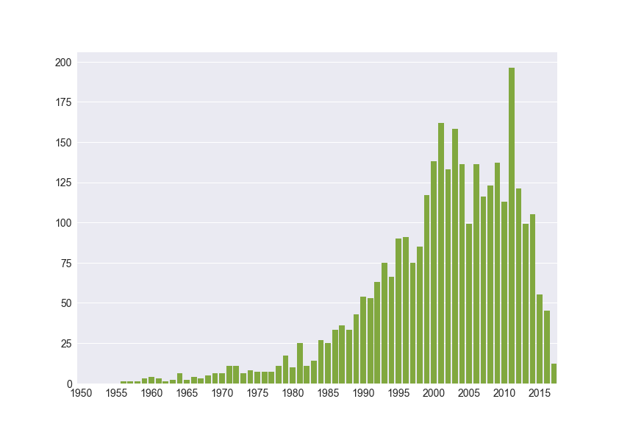
Titles in Library Genesis by Publication Year: The MIT Press
Stephen Reid McLaughlin / @SteveMcLaugh
Notes:
3263 books (deduped)

Slide 98
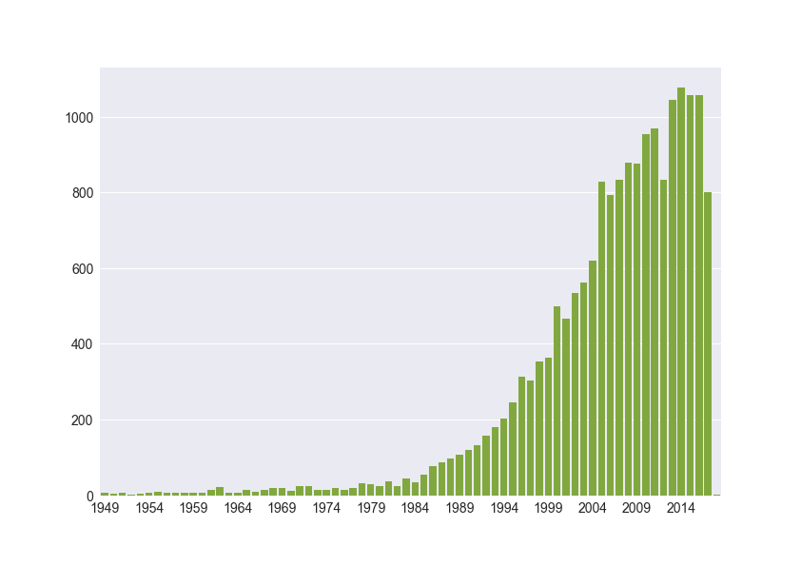
Titles in Library Genesis by Publication Year: Oxford University Press
Stephen Reid McLaughlin / @SteveMcLaugh
Notes:
18275 books (deduped)
OUP publishes around 6,000 titles per year

Slide 99
“Literature in the humanities goes out of print long before it goes out of date.” (Borgman 2007)
Stephen Reid McLaughlin / @SteveMcLaugh
Notes:
1. Serves a useful purpose.
Monograph crisis- more books each year- squeezed library budgets
Conservatism that privileges publishing with academic presses...
Less OA publishing in the humanities
Almost no commercial market other than libraries
--- historians and literary scholars are oft. obscurantists, including me.

Slide 100
Journal | Sci-Hub | Crossref | Coverage
PMLA | 6,324 | 7,414 | 85.3%
Critical Inquiry | 1,509 | 2,684 | 56.2%
Boundary 2 | 1,922 | 2,263 | 84.9%
Journal of Documentation | 1,767 | 2,136 | 82.7%
Renaissance Studies | 1,491 | 1,821 | 81.9%
Computers and the Humanities | 1,607 | 1,607 | 100.0%
Cultural Studies | 1,280 | 1,335 | 95.9%
October | 1,077 | 1,206 | 89.3%
Journal of Modern Literature | 439 | 1,160 | 37.8%
Comparative Literature Studies | 545 | 1,082 | 50.4%
Postmodern Culture | 30 | 990 | 3.0%
Critical Review | 886 | 894 | 99.1%
Digital Scholarship in the Humanities | 180 | 198 | 90.9%
Sci-Hub Stats Browser (Himmelstein et al. 2017): https://greenelab.github.io/scihub/
Stephen Reid McLaughlin / @SteveMcLaugh
Notes:
Very narrow collecting focus:
No issues of Digital Humanities Quarterly are included, for instance.
No Digital Studies
No Journal of the Text Encoding Initiative
… a possible downside to publishing in alternative forms,
Daniel S Himmelstein​1, Ariel R Romero2, Stephen R McLaughlin3, Bastian Greshake Tzovaras4, Casey S Greene​1
My colleagues Daniel Himmelstein and …

Slide 101
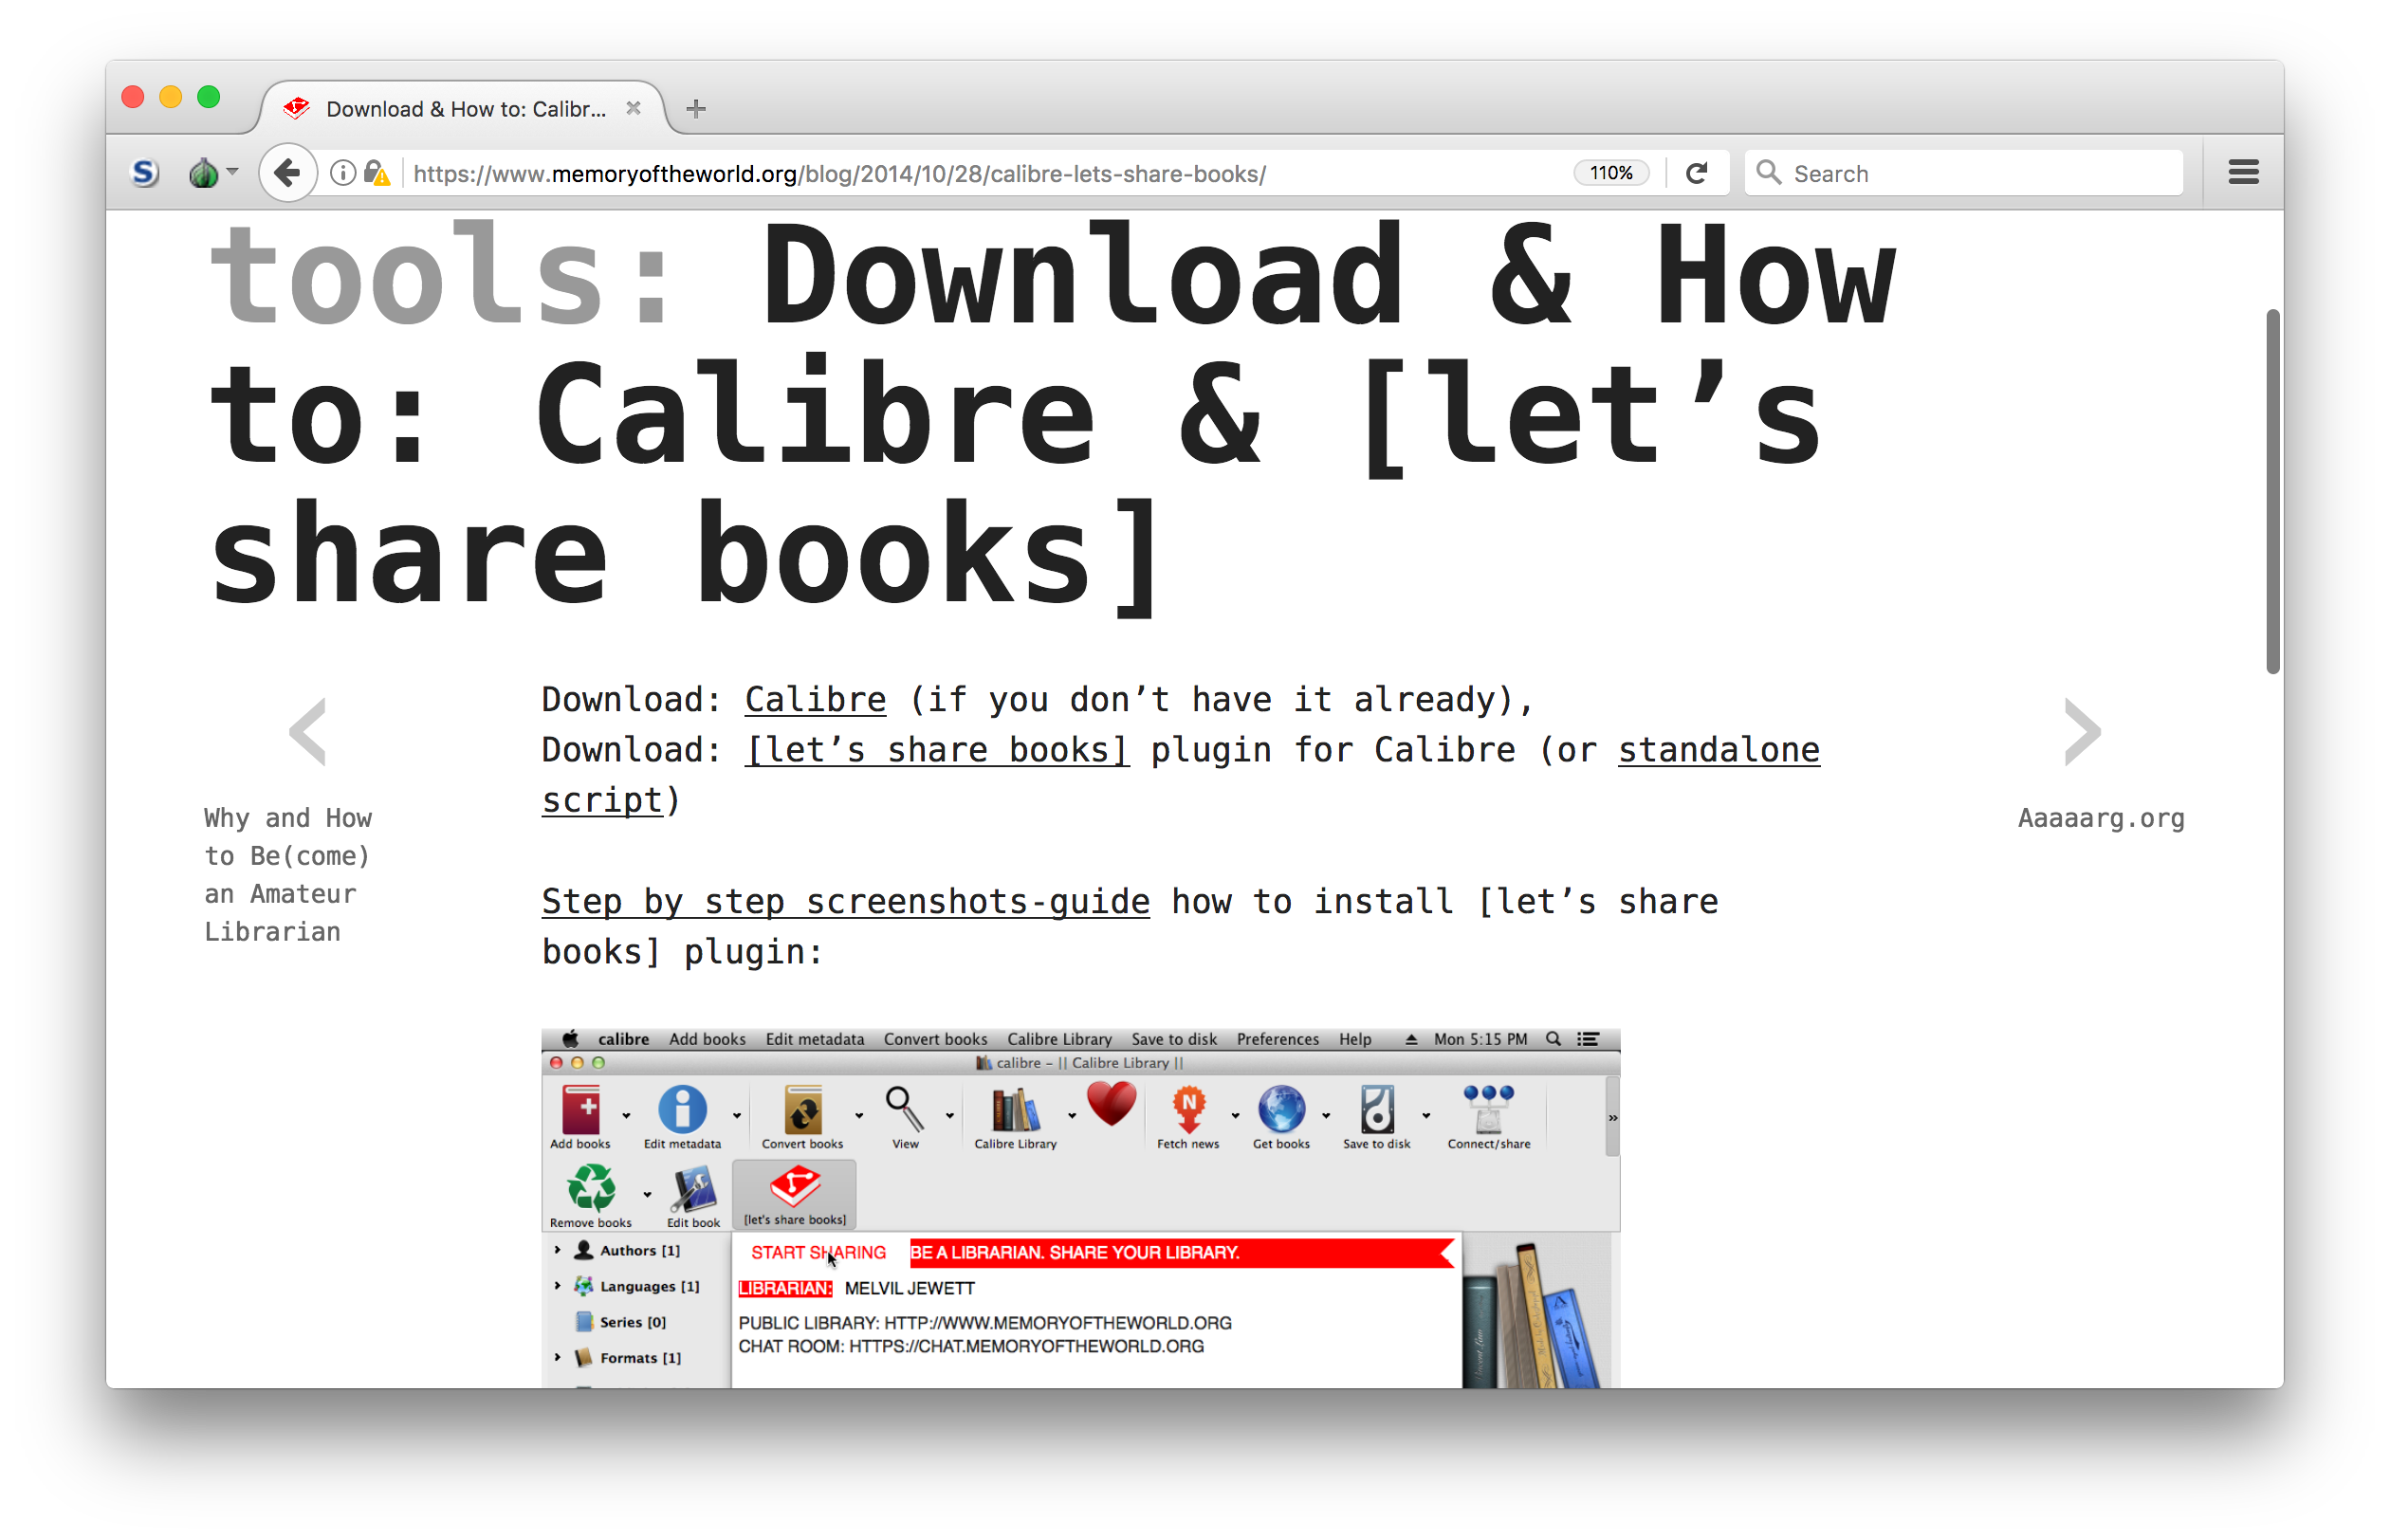
Stephen Reid McLaughlin / @SteveMcLaugh

Slide 102
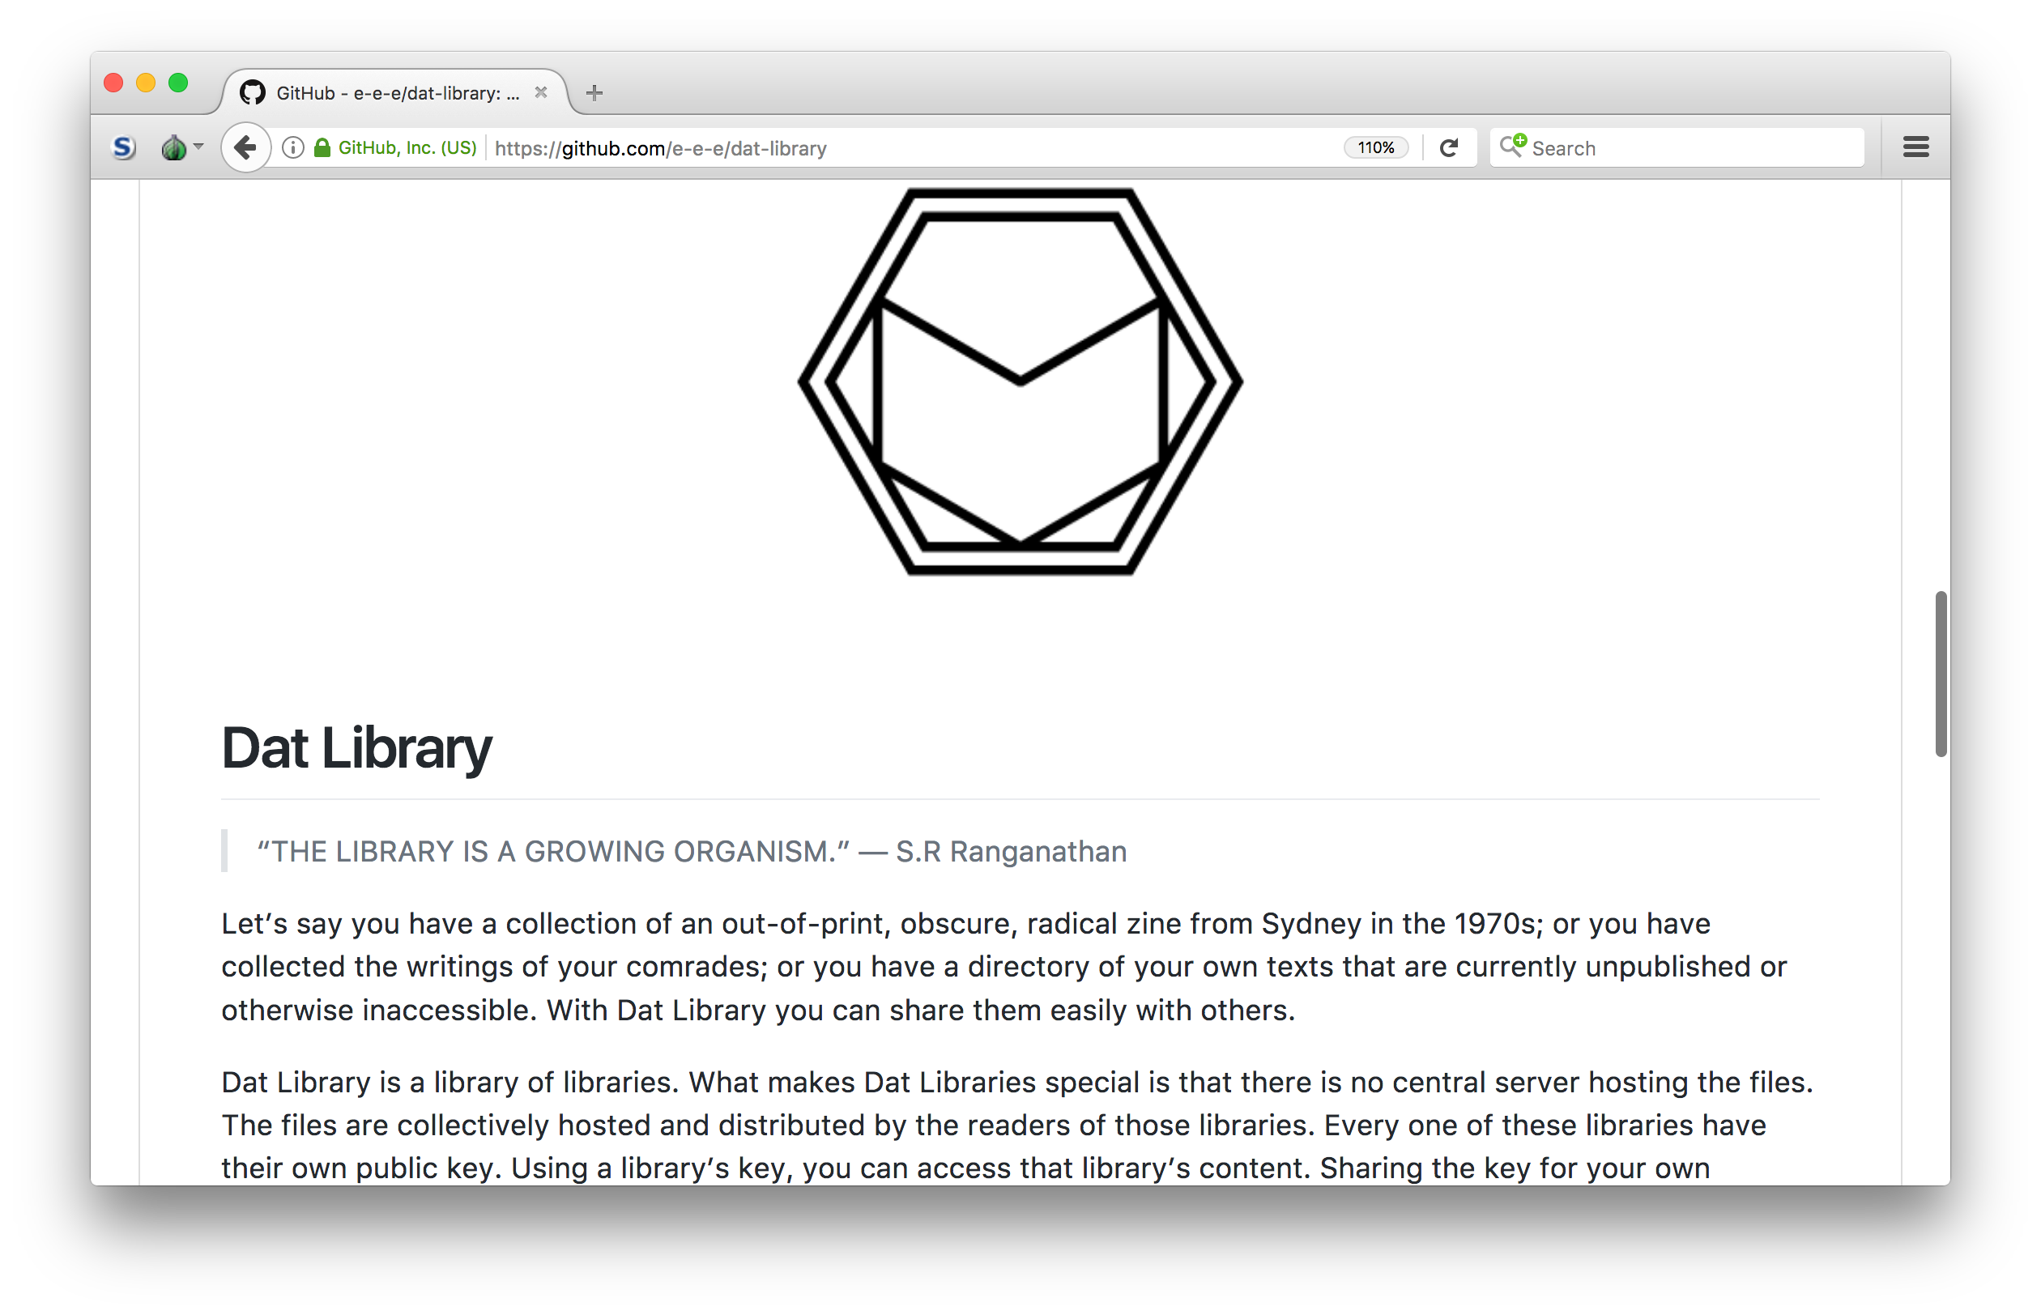
Stephen Reid McLaughlin / @SteveMcLaugh

Slide 103
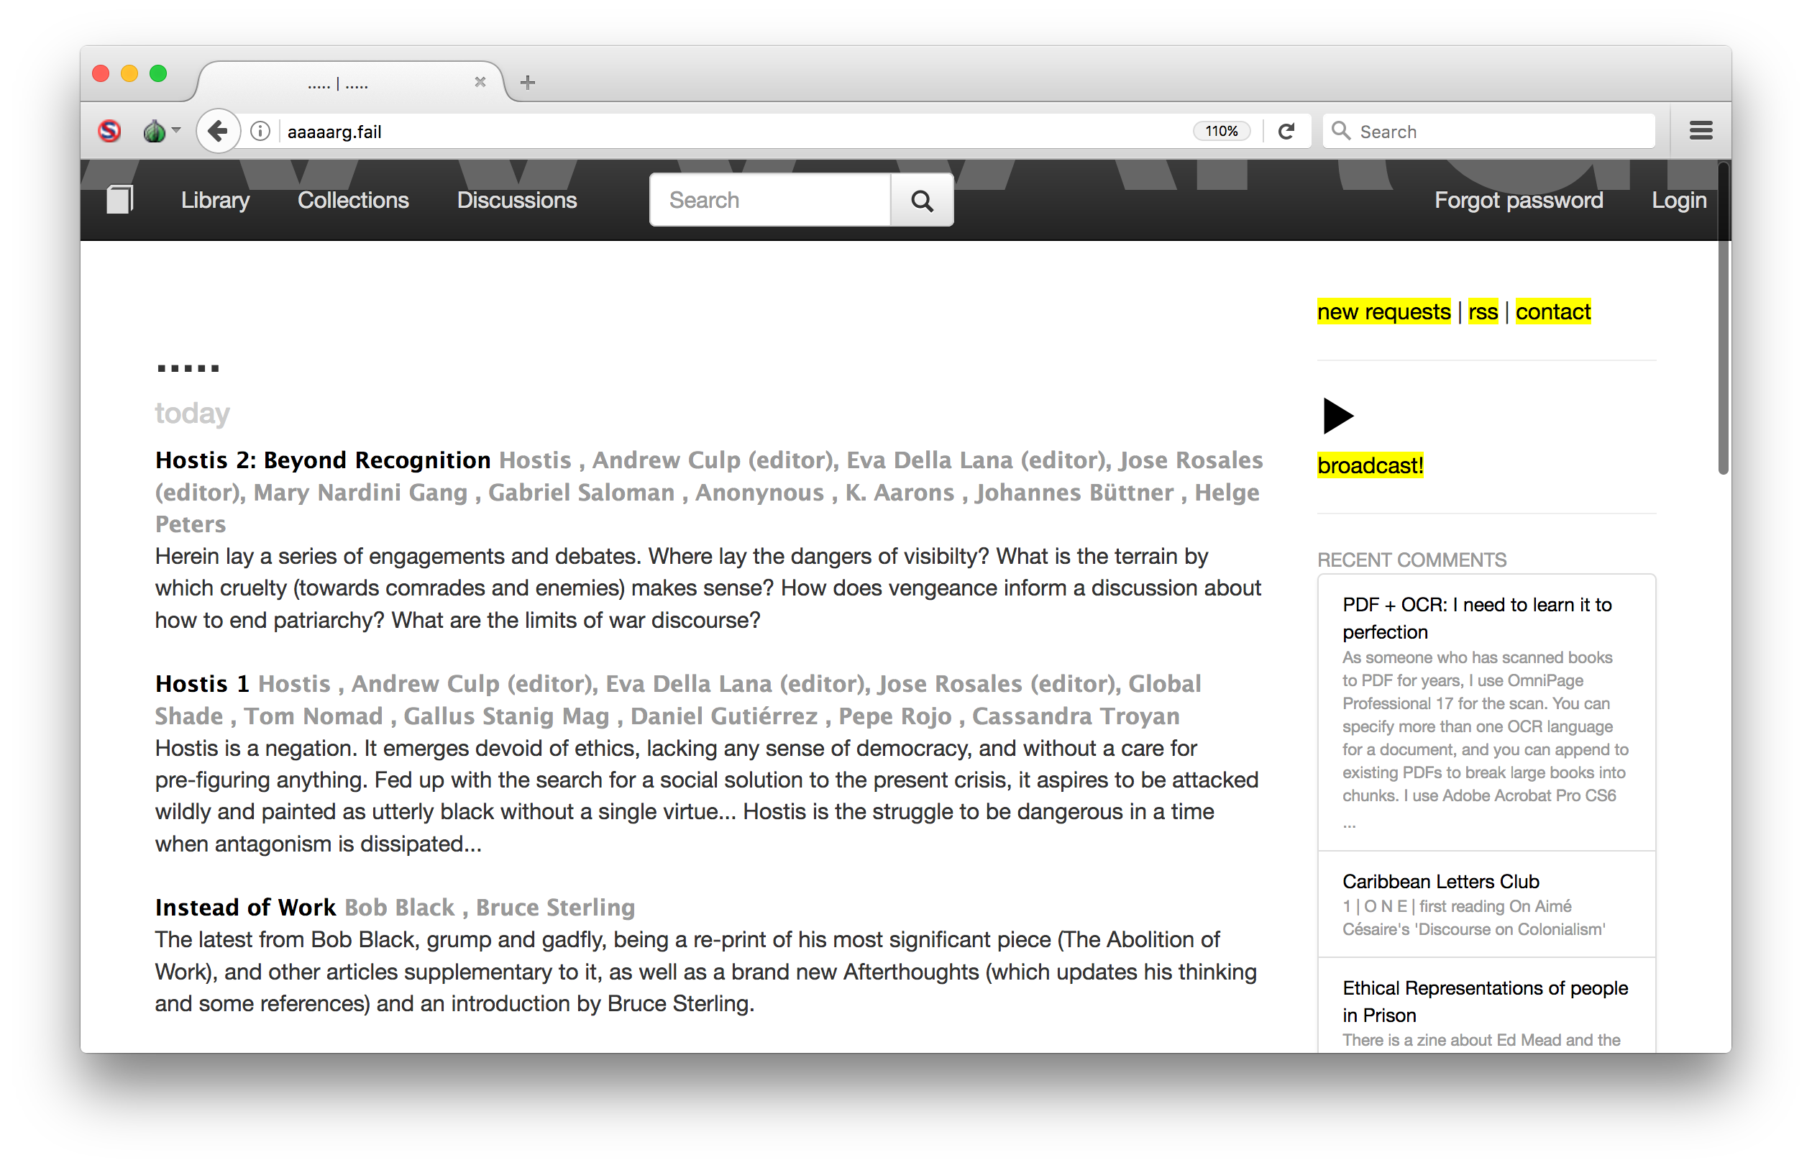
Stephen Reid McLaughlin / @SteveMcLaugh
Notes:
Let me phrase this carefully: Who remembers the existence of Library.nu

Slide 104

What culture can’t you live without?
Stephen Reid McLaughlin / @SteveMcLaugh
Notes:
"repertoires of archiving", which connects to repertoires in social movements
We're used to talking about best practices in Libraries, we're shooting for stable systems.
Here it's taken for granted that organizations will change rapidly, probably sooner than later

Slide 105

Sample Text
Stephen Reid McLaughlin / @SteveMcLaugh
Notes:
"repertoires of archiving", which connects to repertoires in social movements
We're used to talking about best practices in Libraries, we're shooting for stable systems.
Here it's taken for granted that organizations will change rapidly, probably sooner than later

Slide 106

Sample Text
Stephen Reid McLaughlin / @SteveMcLaugh
Notes:
"repertoires of archiving", which connects to repertoires in social movements
We're used to talking about best practices in Libraries, we're shooting for stable systems.
Here it's taken for granted that organizations will change rapidly, probably sooner than later

Slide 107

Sample Text
Stephen Reid McLaughlin / @SteveMcLaugh
Notes:
"repertoires of archiving", which connects to repertoires in social movements
We're used to talking about best practices in Libraries, we're shooting for stable systems.
Here it's taken for granted that organizations will change rapidly, probably sooner than later

Slide 108

Sample Text
Stephen Reid McLaughlin / @SteveMcLaugh
Notes:
"repertoires of archiving", which connects to repertoires in social movements
We're used to talking about best practices in Libraries, we're shooting for stable systems.
Here it's taken for granted that organizations will change rapidly, probably sooner than later

Slide 109
Instrumental aims | Alternatives
counter-hegemony | “subaltern resistance” | Carroll 2010
civil disobedience | direct action | Franks 2003
coherent framing | compelling narrative | Polletta 2009
representation | participation | Melucci 1996
compromise | “non-negotiable demand” | Wark 2004
“territorial dominance” | “opacity and unreadability” | Galloway 2010
party politics | “non-political politics” | Havel 1989
Stephen Reid McLaughlin / @SteveMcLaugh

Slide 110
Early shadow libraries
Kenneth Goldsmith’s UbuWeb (Dockray 2012, 429; Price 2009, 285)
Sebastian Luetgert’s Textz.com (Greene 2003)
Sean Dockray’s AAAAARG (Basile 2016; Hamerman 2015)
Gigapedia/Library.nu (Stinson 2010; Kelty 2012; Liang 2012)
Stephen Reid McLaughlin / @SteveMcLaugh
Notes:
- Meanwhile ...
- Ubu founded in 1996
Sebastian Luetgert’s Textz archive (Greene 2003)
AAAAARG: originally Artists, Architects, and Activists Reading Group – social structure
50K texts (Hamerman 2015)
Gigapedia: 360K documents in 2010
- relatively under-represented in the literature

Slide 111
Librarians as “both promoters of open access and guardians of copyright law.” (Morrison, Stephenson, and Yates 2017, 746)
Stephen Reid McLaughlin / @SteveMcLaugh

Slide 112
work: standing at the scanner
Stephen Reid McLaughlin / @SteveMcLaugh

Slide 113
You can’t take these sites for granted
Stephen Reid McLaughlin / @SteveMcLaugh

Slide 114

Stephen Reid McLaughlin / @SteveMcLaugh
Notes:
"repertoires of archiving", which connects to repertoires in social movements
We're used to talking about best practices in Libraries, we're shooting for stable systems.
Here it's taken for granted that organizations will change rapidly, probably sooner than later

